Slide 1

Unit 7 At the hospital
Lesson 1
Today we`ll:
present and practise the core vocabulary “Health”
review grammar have got/ has got
learn countable and uncountable nouns
act out the dialogue

Slide 2
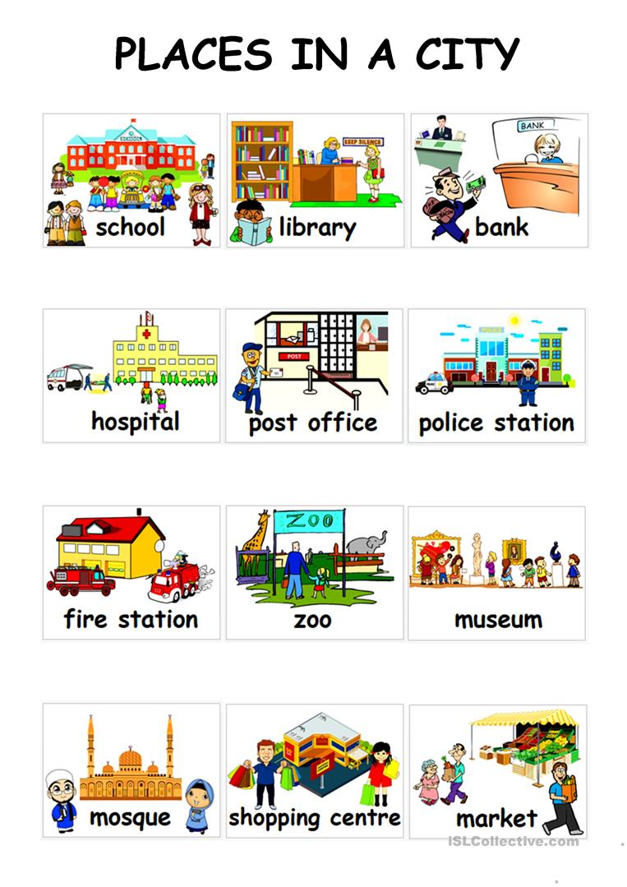
What places are there in our town?
There is a …

Slide 3
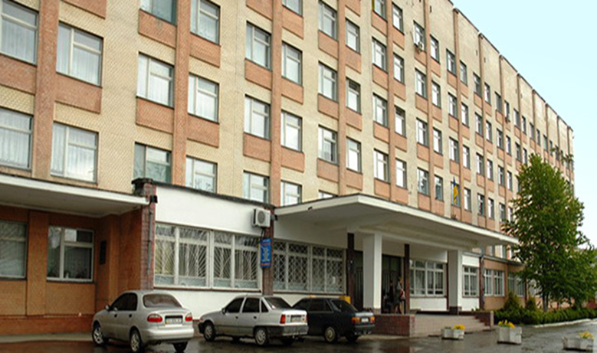
Do you know …?
What`s this?

Slide 4

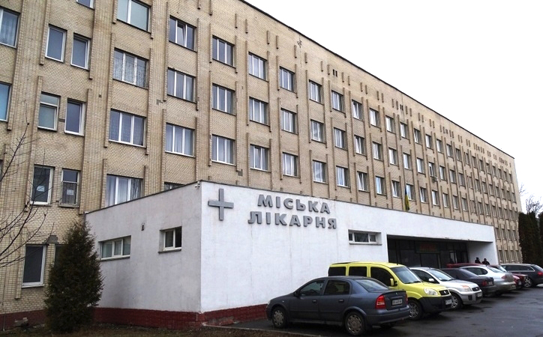
Do you know …?
Where is the hospital in our town?

Slide 5
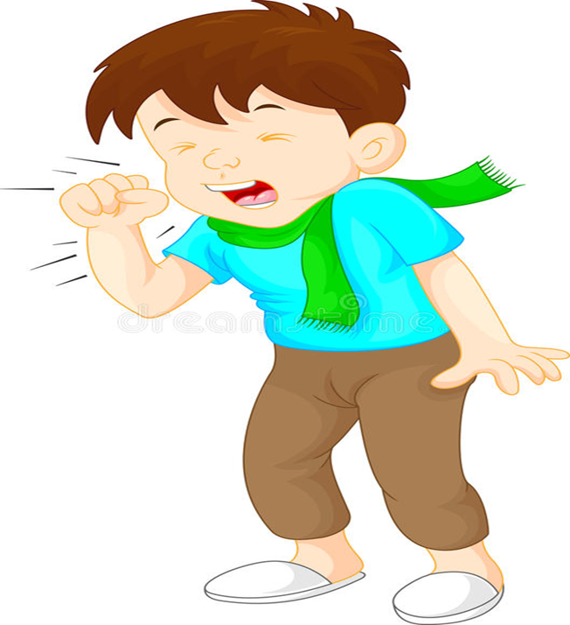
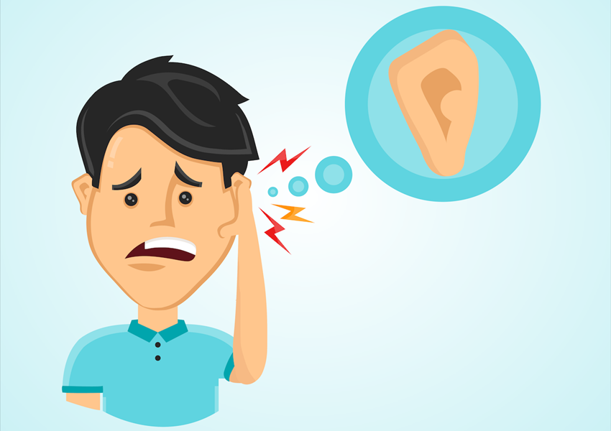
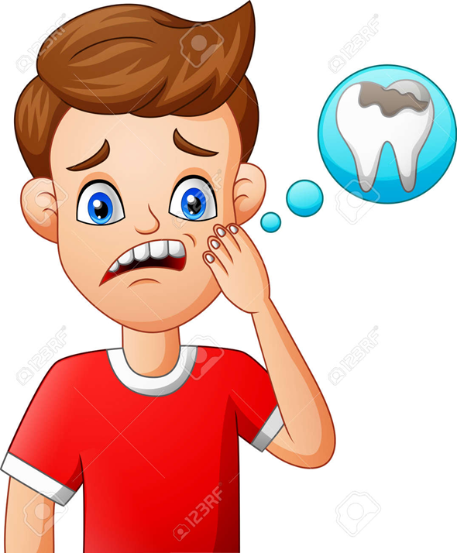
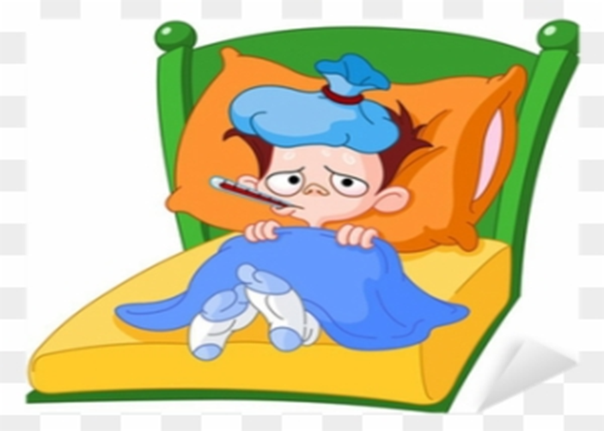
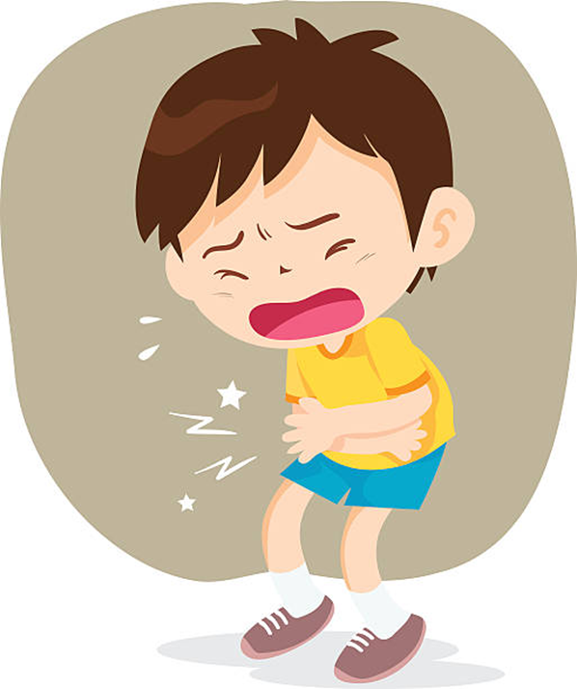
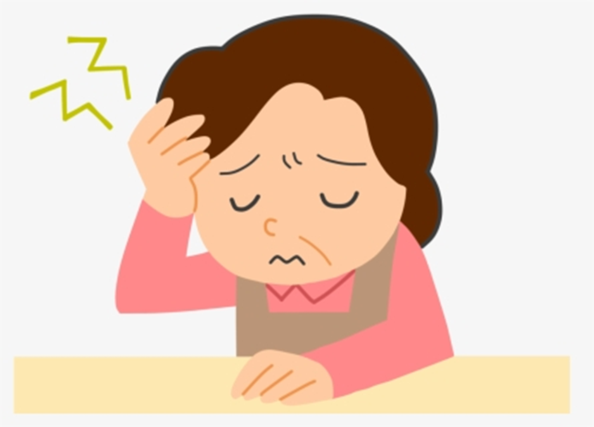
Countable Uncountable
a cough
earache
a cold
toothache
a headache
stomach-ache

Slide 6
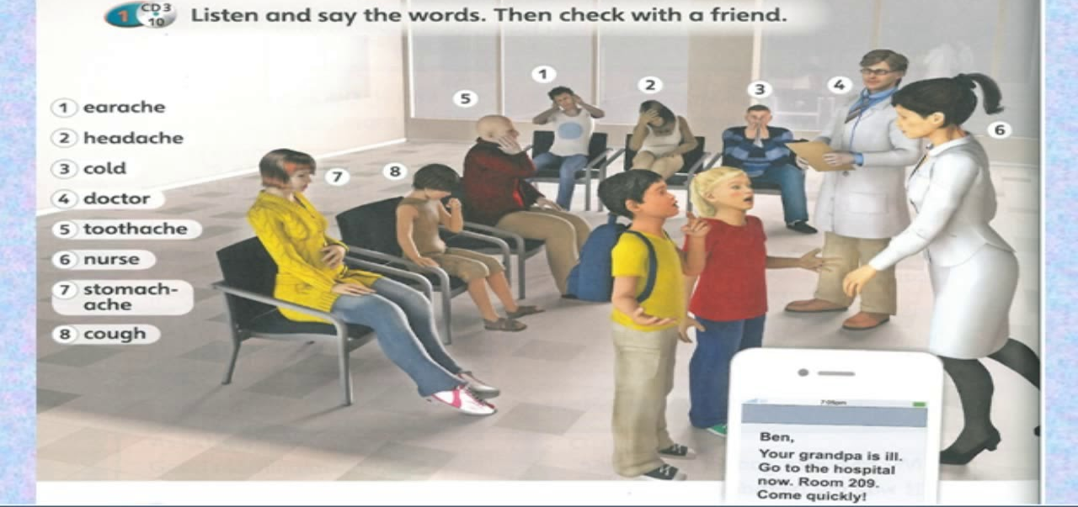
Look at the picture and say:
What`s the problem?

Slide 7
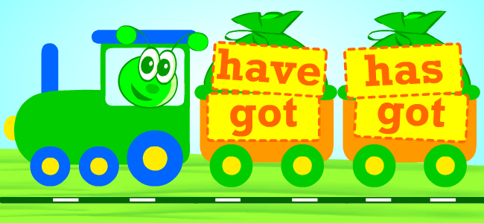


Remember

Slide 8
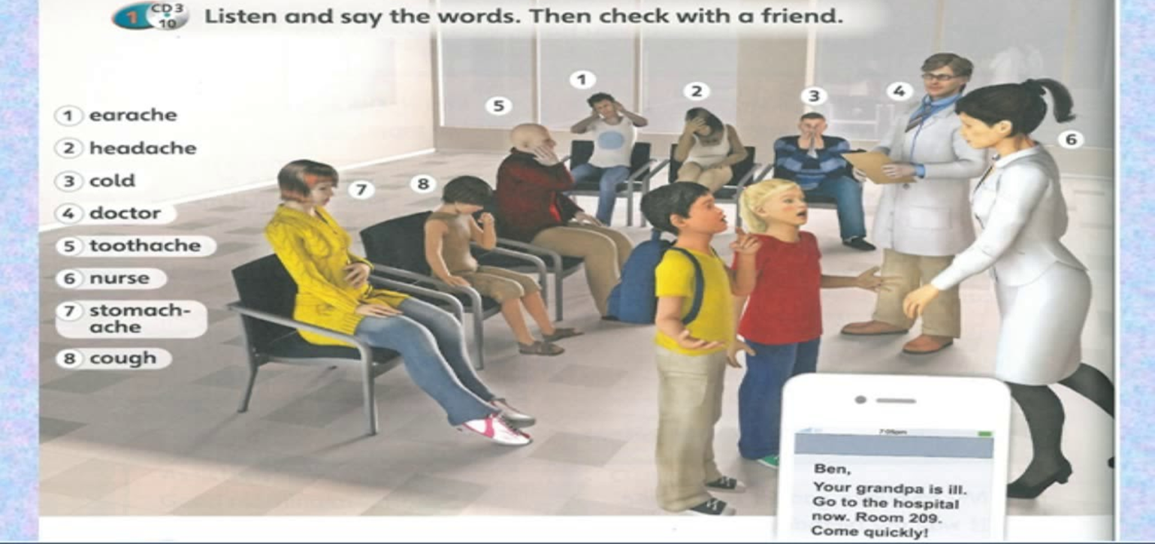
Let`s check
He has got earache.
She has got a headache.
He`s got a cold.
He`s got toothache.
She`s got stomach-ache.
He`s got a cough.

