Slide 1
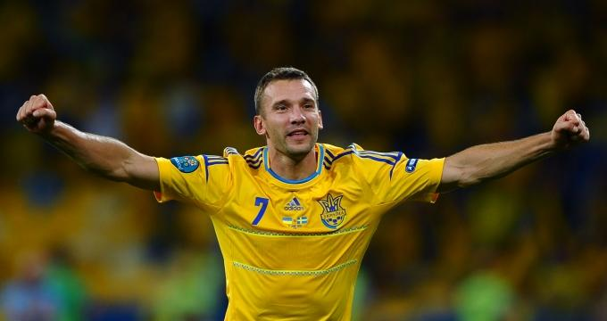
Popular sports and games. Ukrainian sportsmen

Slide 2
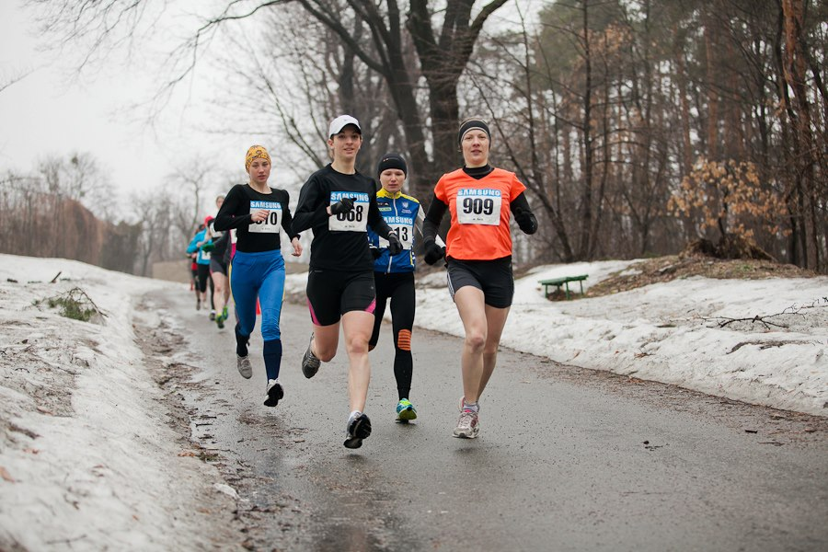
I like to run out in the sun. It's such a fun to run, to run.

Slide 3
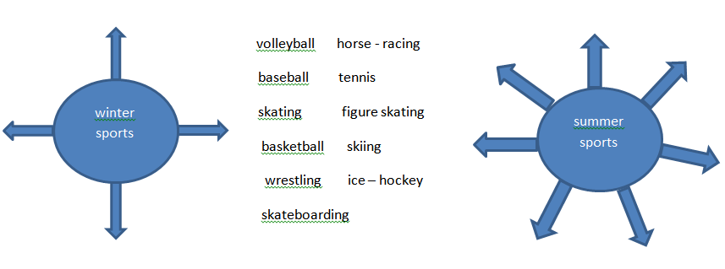
Group these activities into winter and summer sports.
Key:
winter sports: figure skating, skiing, ice hockey, skate boarding;
summer sports: volleyball, baseball, skating, basketball, wrestling, horse – racing, tennis.

Slide 4
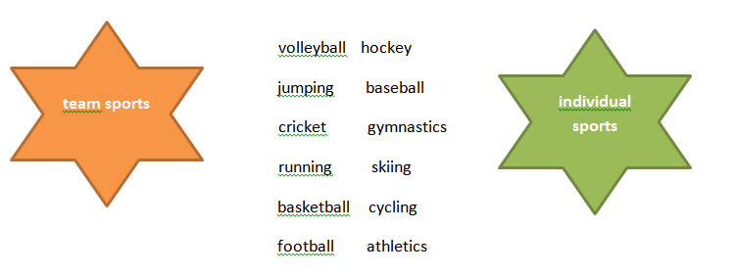
Which are team sports, which are individual sports?
Key:
team sports: volleyball, cricket, basketball, football, hockey, baseball;
individual sports: jumping, running, gymnastics, skiing, cycling, athletics.

Slide 5
Answer the questions.
a) What are the most popular kinds of sport in Great Britain?
b) Who plays cricket in Great Britain?
c) When do people play football?
d) What is Derby?
Key:
a) Cricket, football, rugby, horse – racing, tennis, golf, baseball, grass – hockey, running, jumping, swimming and boxing.
b) Students at school, colleges and universities play cricket.
c) Every Saturday from August till May people play football.
d) It is the most famous sporting event in the whole world.

Slide 6
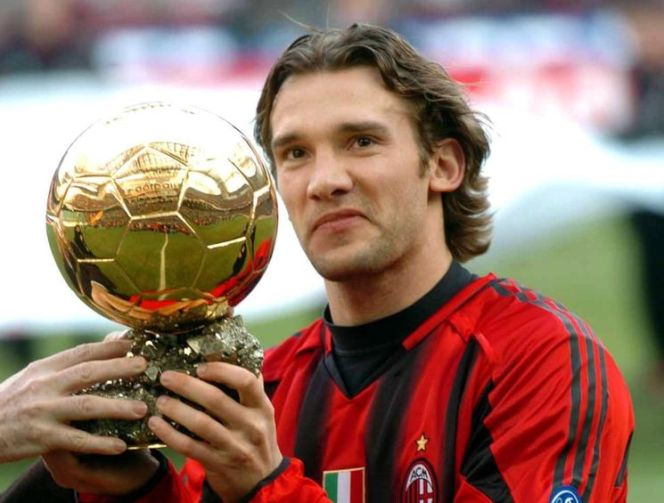
Andrii Shevchenko
Date of birth: 29 September 1976 (Dvirkivshchyna, Kyiv region, Ukraine).
a Ukrainian footballer who plays for Dynamo Kyiv and the Ukraine national team as a striker.
the third – highest scorer in the history of European club competition with 63 goals.
Awards: the Golden Ball and the UEFA Champions League in 2003 with AC Milan.

Slide 7
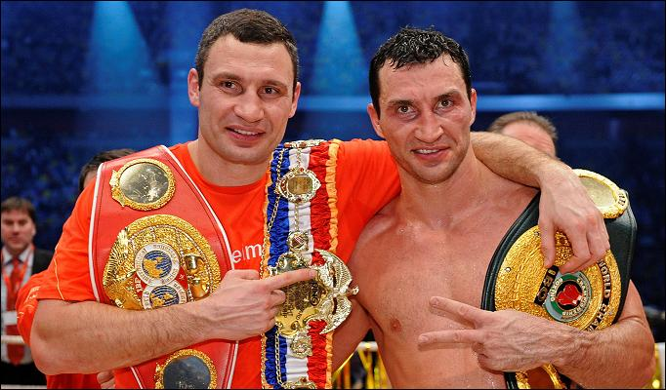
Klychko Brothers
Date of birth: Volodymyr – 25 March 1976 (Semypalatynks, Kazakh SSR), Vitalii – 19 July 1971 (Belovodsk, Kyrgyz SSR) in family of Ukrainians.
Vilatii is the current WBC world heavyweight champion.
Volodymyr is a Ukrainian heavyweight boxer.

Slide 8
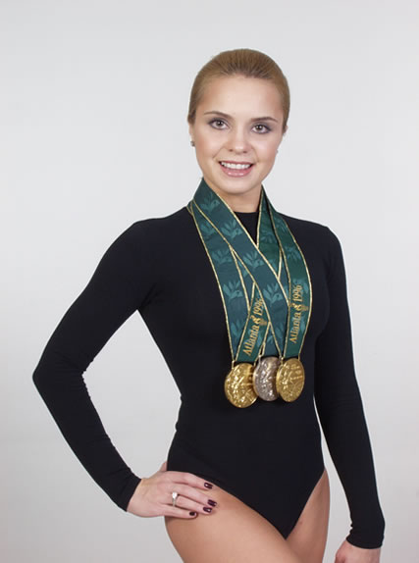
Liliia Podkopaieva
Date of birth: 15 August 1978 (Donetsk, Ukraine).
She is the 1996 Olympic all – around champion.
one of the best gymnasts in the history.
the proud owner of 45 gold, 21 silver and 14 bronze medals.

Slide 9
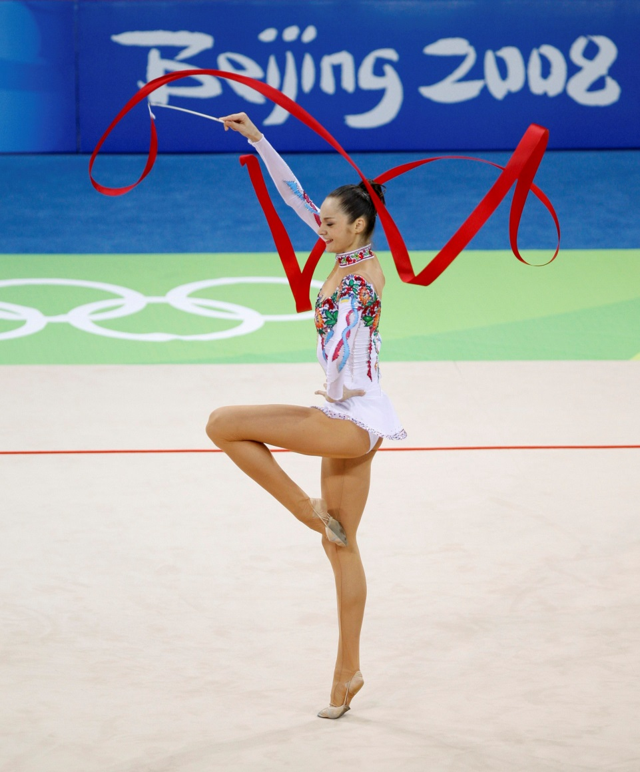
Anna Bessonova
Date of birth: 29 July 1984 (Kyiv, Ukraine).
She is the number one rhythmic gymnast in Ukraine.
won the bronze individual all – around medals at the 2008 Beijing and 2004 Athens Olympics.
won 24 World Championship medals, 2 Olympic medals, 24 European Championship medals and 10 World Cup medals (60 in total).

Slide 10
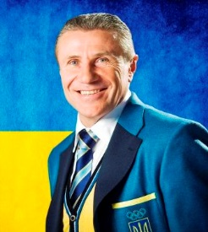
Serhii Bubka
Date of birth: 4 December 1963 (Luhansk, Ukraine).
Six times world champion (between 1983 and 1997).
European champion in 1986 and Olympic champion in 1988.
Broke the world record for men's pole vaulting 35 times.
Holds the current outdoor world record of 6.14m in 1994 in Italy and the current indoor world record of 6.15m in 1993 in Donetsk, Ukraine.

Slide 11
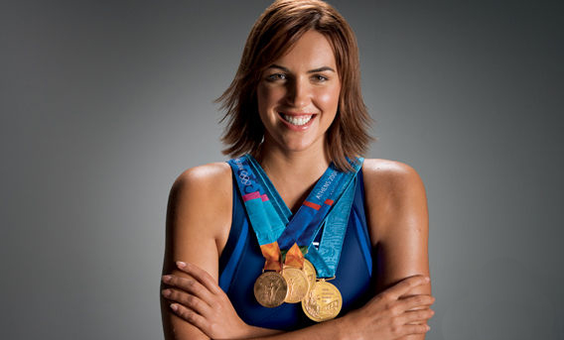
Yana Klochkova
Date of birth: 7 August 1982 (Simferopol, Crimea, Ukraine).
She is a Ukrainian swimmer who has won 5 Olympic medals, 4 gold medals came in the 200 meter individual medley and the 400 meter individual medley at the 2000 and 2004 Summer Olympics.
Her silver medal came in the 800 meter freestyle at the 2000 Summer Olympics.

Slide 12
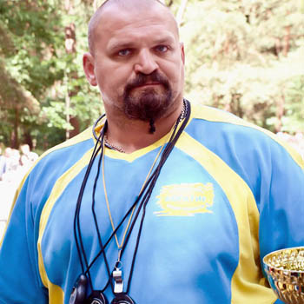
Vasyl Virastiuk
Date of birth: 22 April 1974 (Ivano – Frankivsk, Ukraine).
He is a strongman competitor from Ukraine who competed in the finals of the World's Strongest Man contest in 2003 (3-rd place) and 2004 (1-st place).
He won the 2007 IFSA Strongman World Championship.

Slide 13
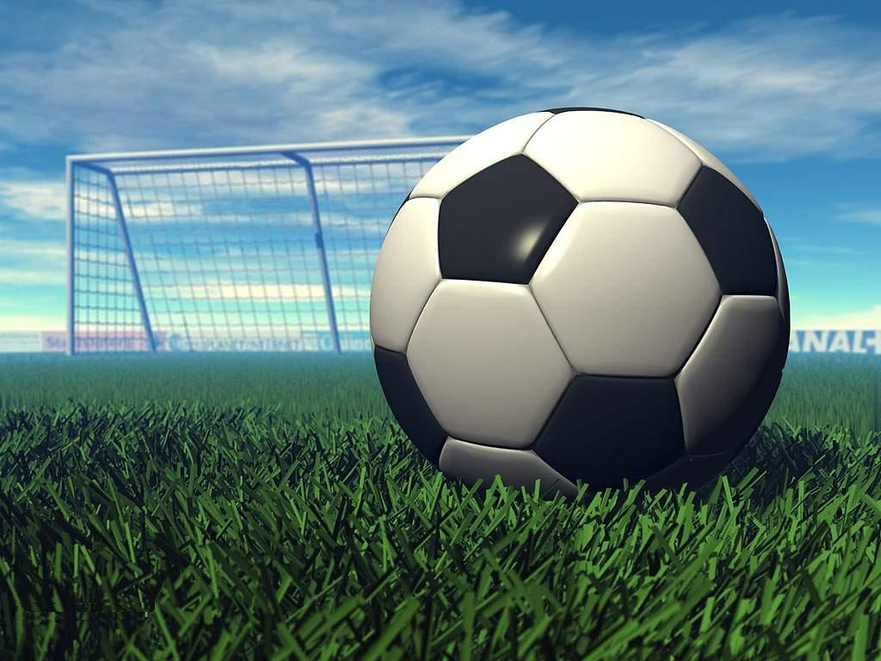
HOME ASSIGNMENT
Написати про улюбленого спортсмена.

Slide 14
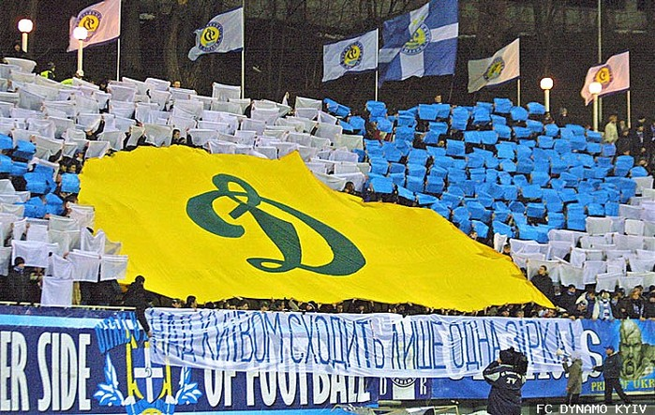
Thank you. Goodbye!

