Slide 1

Do you need a book?
Your preferences

Slide 2
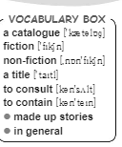
Find the words from the box (p. 115) in the text and complete the sentences below with them.
I've read one of her books, but I can't remember the … .
I want to … my lawyer before I say anything.
His first novel won a prize for modern … .
There is a new … of all the books in the library.
The books in the library are divided into fiction and … .
…, more than two hundred students study in this library every day.
It's a … story. It isn't true. I don't believe a word of it.
It is important to eat meat or eggs, as they … protein and vitamins.

Slide 3
Find the words from the box (p. 115) in the text and complete the sentences below with them.
I've read one of her books, but I can't remember the title .
I want to … my lawyer before I say anything.
His first novel won a prize for modern … .
There is a new … of all the books in the library.
The books in the library are divided into fiction and … .
…, more than two hundred students study in this library every day.
It's a … story. It isn't true. I don't believe a word of it.
It is important to eat meat or eggs, as they … protein and vitamins.

Slide 4
Find the words from the box (p. 115) in the text and complete the sentences below with them.
I've read one of her books, but I can't remember the title .
I want to consult my lawyer before I say anything.
His first novel won a prize for modern … .
There is a new … of all the books in the library.
The books in the library are divided into fiction and … .
…, more than two hundred students study in this library every day.
It's a … story. It isn't true. I don't believe a word of it.
It is important to eat meat or eggs, as they … protein and vitamins.

Slide 5
Find the words from the box (p. 115) in the text and complete the sentences below with them.
I've read one of her books, but I can't remember the title .
I want to consult my lawyer before I say anything.
His first novel won a prize for modern fiction .
There is a new … of all the books in the library.
The books in the library are divided into fiction and … .
…, more than two hundred students study in this library every day.
It's a … story. It isn't true. I don't believe a word of it.
It is important to eat meat or eggs, as they … protein and vitamins.

Slide 6
Find the words from the box (p. 115) in the text and complete the sentences below with them.
I've read one of her books, but I can't remember the title .
I want to consult my lawyer before I say anything.
His first novel won a prize for modern fiction .
There is a new catalogue of all the books in the library.
The books in the library are divided into fiction and … .
…, more than two hundred students study in this library every day.
It's a … story. It isn't true. I don't believe a word of it.
It is important to eat meat or eggs, as they … protein and vitamins.

Slide 7
Find the words from the box (p. 115) in the text and complete the sentences below with them.
I've read one of her books, but I can't remember the title .
I want to consult my lawyer before I say anything.
His first novel won a prize for modern fiction .
There is a new catalogue of all the books in the library.
The books in the library are divided into fiction and non-fiction .
…, more than two hundred students study in this library every day.
It's a … story. It isn't true. I don't believe a word of it.
It is important to eat meat or eggs, as they … protein and vitamins.

Slide 8
Find the words from the box (p. 115) in the text and complete the sentences below with them.
I've read one of her books, but I can't remember the title .
I want to consult my lawyer before I say anything.
His first novel won a prize for modern fiction .
There is a new catalogue of all the books in the library.
The books in the library are divided into fiction and non-fiction .
In general, more than two hundred students study in this library every day.
It's a … story. It isn't true. I don't believe a word of it.
It is important to eat meat or eggs, as they … protein and vitamins.

Slide 9
Find the words from the box (p. 115) in the text and complete the sentences below with them.
I've read one of her books, but I can't remember the title .
I want to consult my lawyer before I say anything.
His first novel won a prize for modern fiction .
There is a new catalogue of all the books in the library.
The books in the library are divided into fiction and non-fiction .
In general, more than two hundred students study in this library every day.
It's a made-up story. It isn't true. I don't believe a word of it.
It is important to eat meat or eggs, as they … protein and vitamins.

Slide 10
Find the words from the box (p. 115) in the text and complete the sentences below with them.
I've read one of her books, but I can't remember the title .
I want to consult my lawyer before I say anything.
His first novel won a prize for modern fiction .
There is a new catalogue of all the books in the library.
The books in the library are divided into fiction and non-fiction .
In general, more than two hundred students study in this library every day.
It's a made-up story. It isn't true. I don't believe a word of it.
It is important to eat meat or eggs, as they contain protein and vitamins.

Slide 11
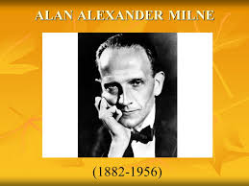

Do ex. 6, p. 127. Fill in the chart

Slide 12

1882
 | won a scholarship
1913
 | completed a book an several plays
 | his son was born
1923
1924
 | Winnie-the-Pooh was published
1939
 | Milne died, 30 years later after publishing Winnie-the-Pooh

Slide 13
1882 | was born in London
1893 | won a scholarship
1913 | he married Dorothy De Selincourt
1919 | completed a book and several plays
1920 | his son was born
1923 | began to work on a collection of poems for children
1924 | “When we were young” was published
1926 | Winnie-the-Pooh was published
1939 | his autobiography was published
1956 | Milne died, 30 years later after publishing Winnie-the-Pooh

Slide 14
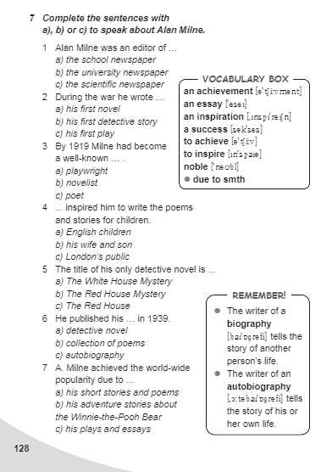

Slide 15
Complete the sentences below with the words from the box.
poetry, amusing, an emotional, author, emotion, genre
It was … game for all of us.
He read me some of his … .
I don't find his jokes at all … .
Her voice was fool of … .
This movie is much better than others of the horror … .
The … has signed the book on the title page.

Slide 16
Complete the sentences below with the words from the box.
poetry, amusing, an emotional, author, emotion, genre
It was an emotional game for all of us.
He read me some of his … .
I don't find his jokes at all … .
Her voice was fool of … .
This movie is much better than others of the horror … .
The … has signed the book on the title page.

Slide 17
Complete the sentences below with the words from the box.
poetry, amusing, an emotional, author, emotion, genre
It was an emotional game for all of us.
He read me some of his poetry .
I don't find his jokes at all … .
Her voice was fool of … .
This movie is much better than others of the horror … .
The … has signed the book on the title page.

Slide 18
Complete the sentences below with the words from the box.
poetry, amusing, an emotional, author, emotion, genre
It was an emotional game for all of us.
He read me some of his poetry .
I don't find his jokes at all amusing.
Her voice was fool of … .
This movie is much better than others of the horror … .
The … has signed the book on the title page.

Slide 19
Complete the sentences below with the words from the box.
poetry, amusing, an emotional, author, emotion, genre
It was an emotional game for all of us.
He read me some of his poetry.
I don't find his jokes at all amusing.
Her voice was full of emotion.
This movie is much better than others of the horror … .
The … has signed the book on the title page.

Slide 20
Complete the sentences below with the words from the box.
poetry, amusing, an emotional, author, emotion, genre
It was an emotional game for all of us.
He read me some of his poetry.
I don't find his jokes at all amusing.
Her voice was full of emotion.
This movie is much better than others of the horror genre.
The … has signed the book on the title page.

Slide 21
Complete the sentences below with the words from the box (p. 117).
poetry, amusing, an emotional, author, emotion, genre
It was an emotional game for all of us.
He read me some of his poetry.
I don't find his jokes at all amusing.
Her voice was full of emotion.
This movie is much better than others of the horror genre.
The author has signed the book on the title page.

Slide 22
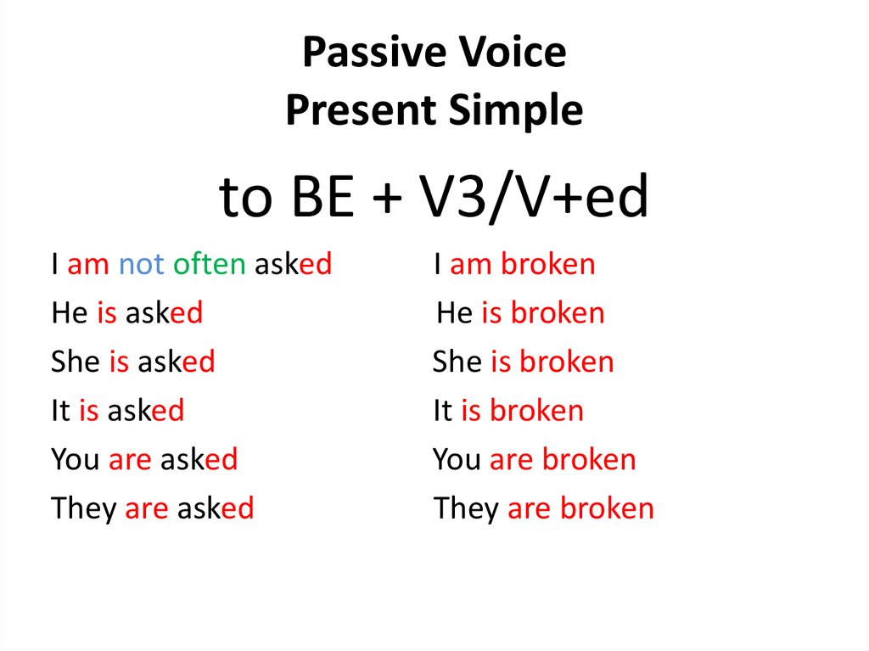
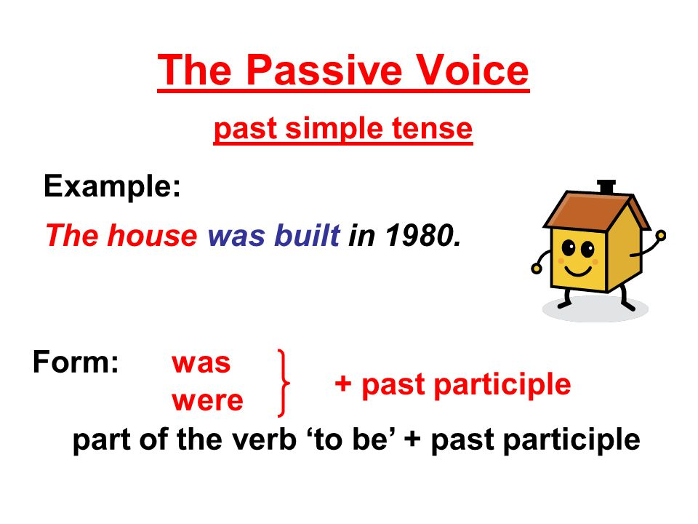
GRAMMAR

Slide 23
Complete the sentences with Passive Voice.
If I eat a cake, the cake … (is eaten).
If I send a letter, the letter … .
If I spend my money, the money … .
If I catch a fly, the fly … .
If I buy a plane, the plane … .
If I draw a picture, the picture … .
If I grow a tree, the tree … .
If I meet my friend, my friend … .

Slide 24
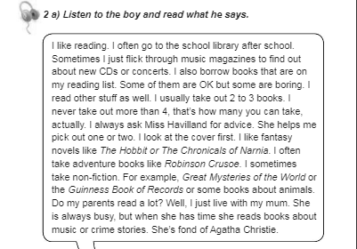

Good luck!
Домашнє завдання

