Slide 1

Favourite fairy tales

Slide 2
Тема уроку: Спляча красуня.
Тип уроку: Урок домашнього читання
Цілі:
вдосконалювати навички вживання Past Simple і навички вимови, усного мовлення й письма; розвивати мовну здогадку та комунікативні здібності учнів;
тренувати учнів у читанні п’єси; прищеплювати любов до читання і виховувати загальну культуру учнів.
Обладнання:
підручник, робочий зошит, граматична таблиця, проектор, ноутбук, ілюстрації казки.

Slide 3
Revise the words
Be – was , were
Come-came
Do-did
Have-had
Find- found
Forget-forgot
Make- made
Sleep-slept
Take-took
Hear-heard
Wake up-woke up
Fall-fell
Shine-shone

Slide 4
PAST SIMPLE
Verbs (Дієслова)
Regular Irregular
Правильні Неправильні
Ved V2

Slide 5
THE NEW WORDS
Narrator - автор
13th Wise Woman- 13та чаклунка
King - король
Queen-королева
Princess Rosamond -принцеса
Prince - принц
Peddler- торговець

Slide 6
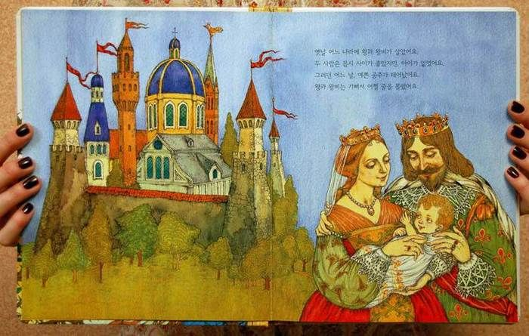
SLEEPING BEAUTY
PART I

Slide 7
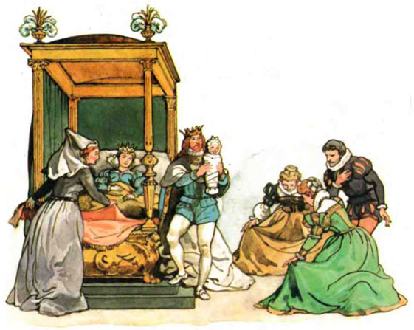
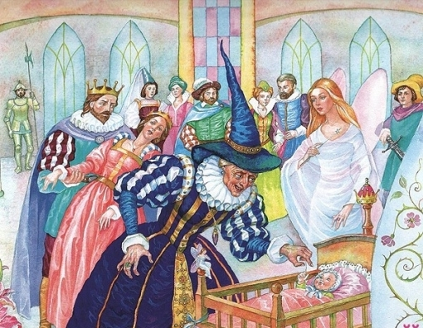
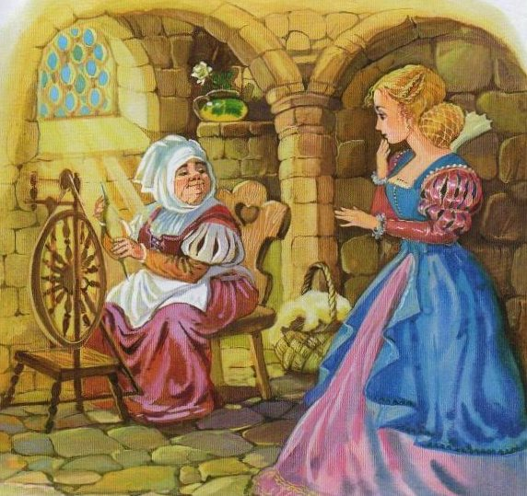
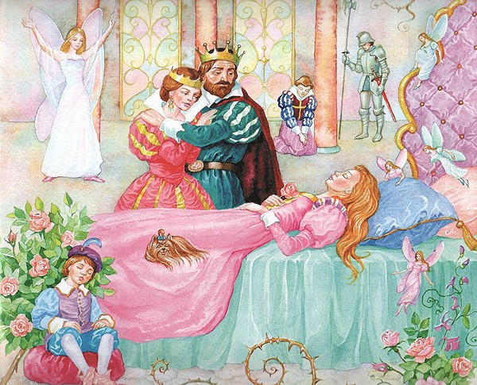

Slide 8
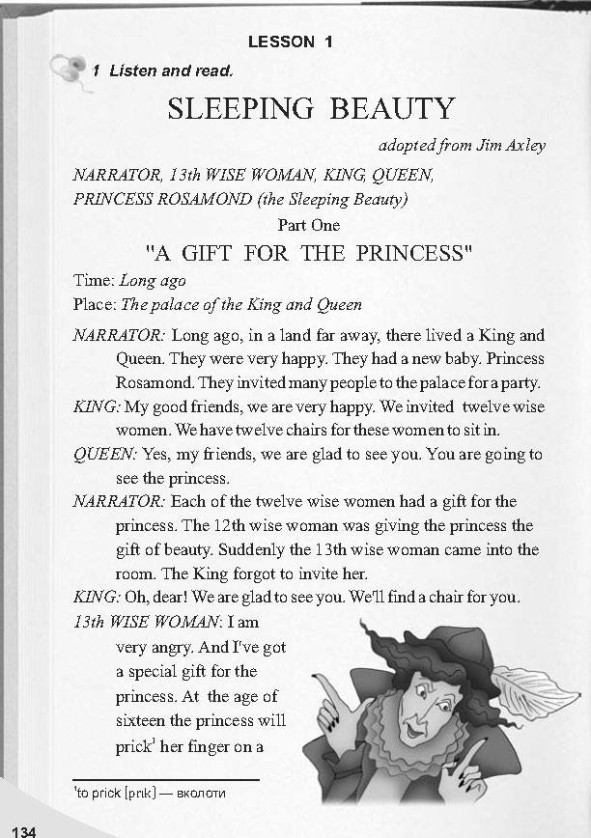
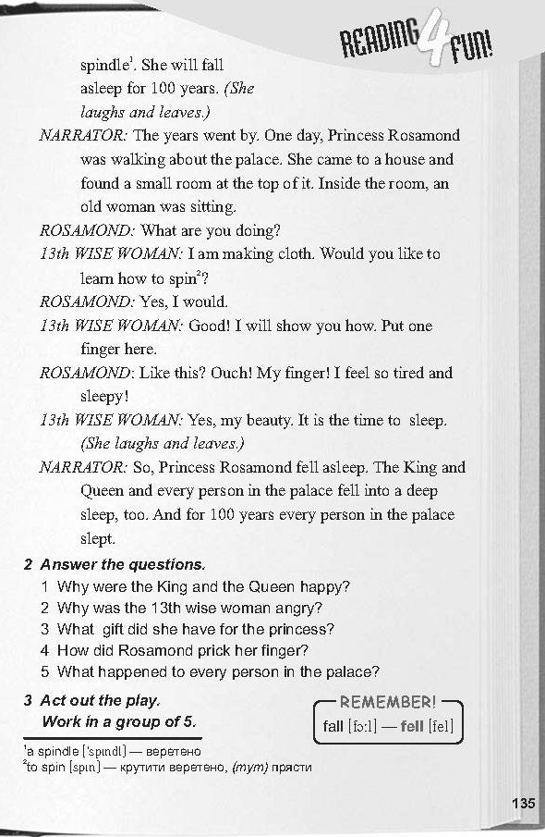

Slide 9
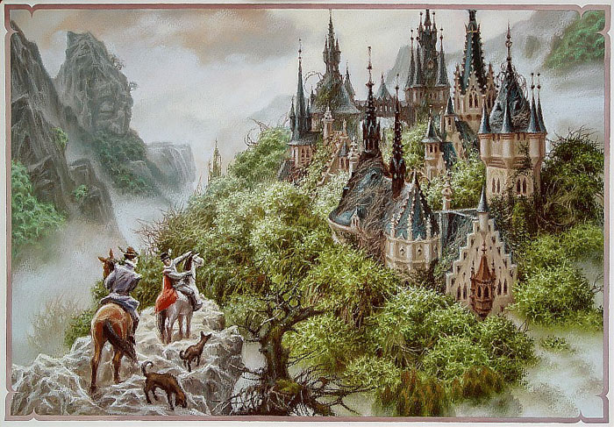
SLEEPING BEAUTY
PART II
100 YEARS LATER

Slide 10
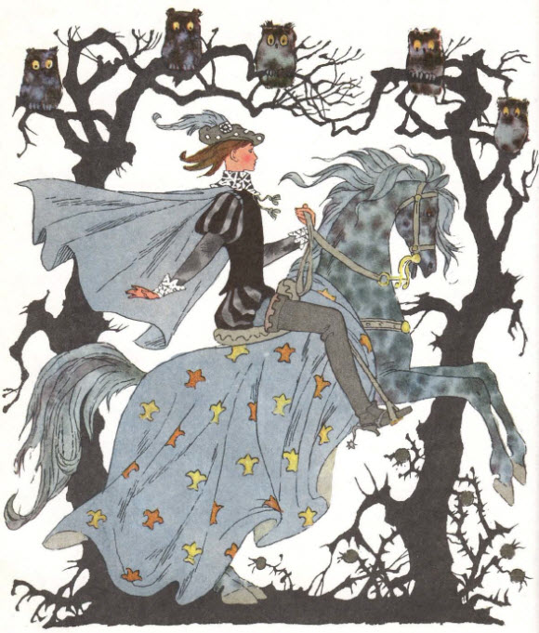
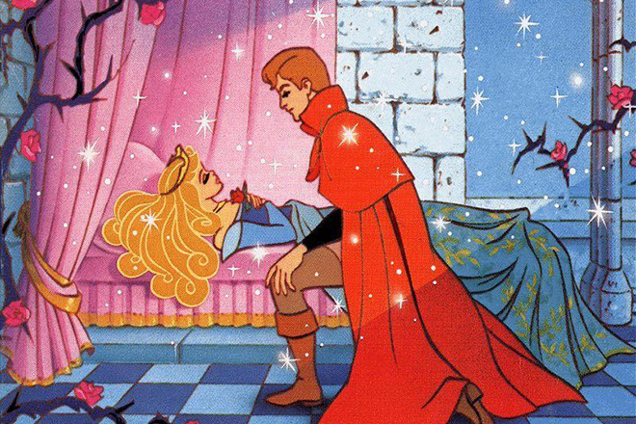
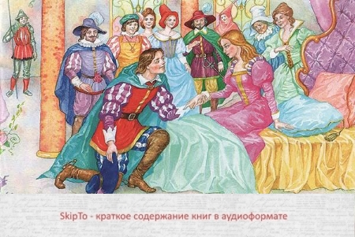
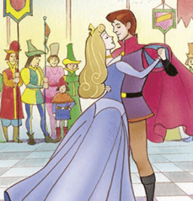

Slide 11
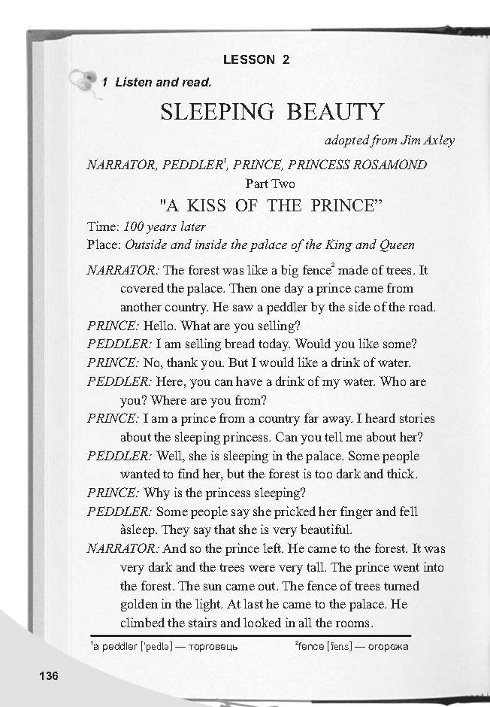
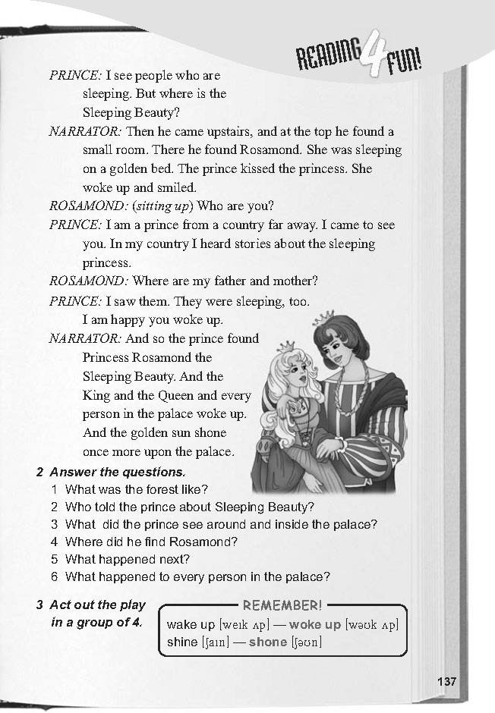

Slide 12
Task 1. True or False statements.
1. The King And the Queen had a son.
2.The King invited 13 wise women
3. 13th wise woman gave a gift of spindle.
4. The Princes Rosamond prick her finger.
5. Everybody slept in the palace.
6. The Prince went to the palace.
7. The Prince didn’t wake up the Princes.
8. The Princes Rosamond was very beautiful.

Slide 13
Task 2. Match the words in Present Simple with Past Simple
Invite
Forget
Go
Come
Sleep
See
Want
Look
Find
Wake up
Woke up
Looked
Came
Found
Wanted
Slept
Saw
Went
Forgot
Invited

Slide 14
Task 1. Answer the questions.
1. Do you like this fairy tale?
2. Why were the king and the Queen happy?
3. Why was the 13th wise woman angry?
4. What gift did she have for the princes?
5. What happened with everybody in the palace?
6. Who told the Prince about Sleeping Beauty?
7. What happened then?

Slide 15
Task 4. Complete the sentences.
We invited twelve wise woman….
Suddenly the 13th wise…
One day, Princes Rosamond…
And for 100 years…
The forest was like …
Some people say she ….
She was sleeping on a …
And the golden sun …

Slide 16

Summing up.
What have you done at the lesson today?
Is this fairy tale interesting?
Which character did you like most of all?
Homework.
Описати улюбленого героя
(біля 5-7 речень).

Slide 17
Task 4. Find the following words in the text and match them with the Ukrainian equivalents. (Reserve activities)
long ago
Invite
Wise
Gift
Fall asleep
Palace
Spin
Make a cloth
spindle
Мудрий
Палац
Запрошувати
веретено
заснути
давним – давно
прясти
робити одяг
подарунок

