Slide 1





Slide 2

Click on the picture
1/13
wash the dishes

Slide 3
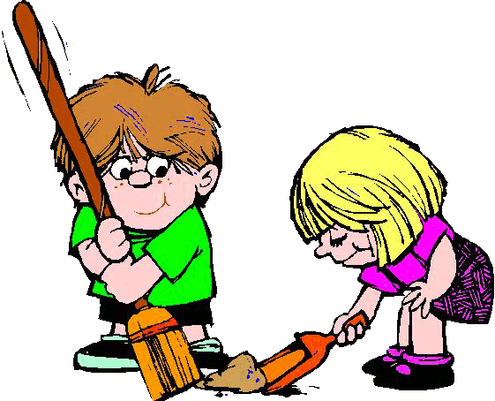

Click on the picture
2/13
sweep the floor

Slide 4


Click on the picture
3/13
mop the floor

Slide 5



Click on the picture
4/13
vacuum the carpet

Slide 6

Click on the picture
5/13
wash the windows

Slide 7
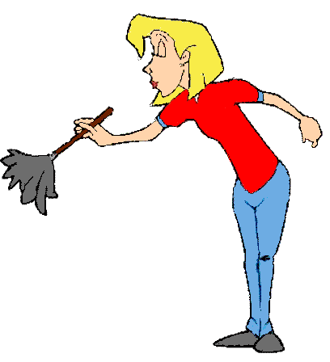
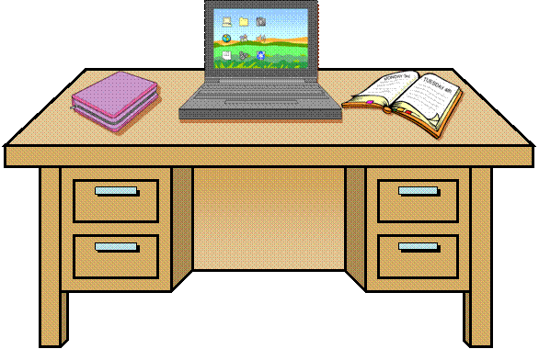
Click on the picture
6/13
dust the furniture

Slide 8

Click on the picture
7/13
wash the clothes

Slide 9

Click on the picture
8/13
iron the clothes

Slide 10
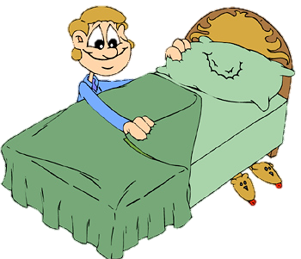
Click on the picture
9/13
make the bed

Slide 11

Click on the picture
10/13
cook the meals

Slide 12

Click on the picture
11/13
set the table

Slide 13

Click on the picture
12/13
take out the trash

Slide 14

Click on the picture
13/13
water the plants

Slide 15



CHORES FOR TODAY
cook the meals
wash the dishes
dust the furniture
set the table
Click on the correct option

Slide 16

CHORES FOR TODAY
take out the trash
iron the clothes
dust the furniture
set the table
Click on the correct option

Slide 17

CHORES FOR TODAY
iron the clothes
water the plants
dust the furniture
set the table
Click on the correct option

Slide 18

CHORES FOR TODAY
mop the floor
dust the furniture
iron the clothes
wash the clothes
Click on the correct option

Slide 19

CHORES FOR TODAY
vacuum the carpet
mop the floor
dust the furniture
sweep the floor
Click on the correct option

Slide 20
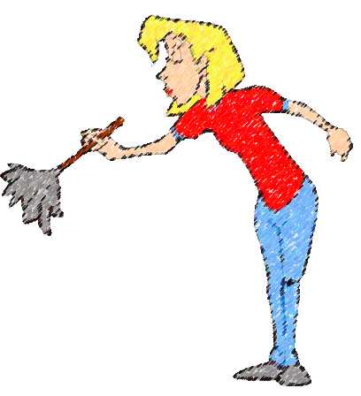
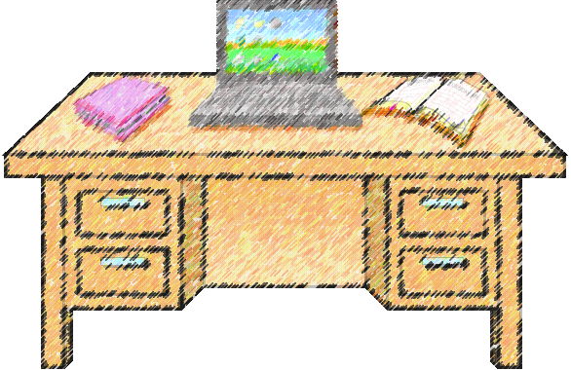
CHORES FOR TODAY
vacuum the carpet
dust the forniture
sweep the floor
wash the clothes
Click on the correct option

Slide 21



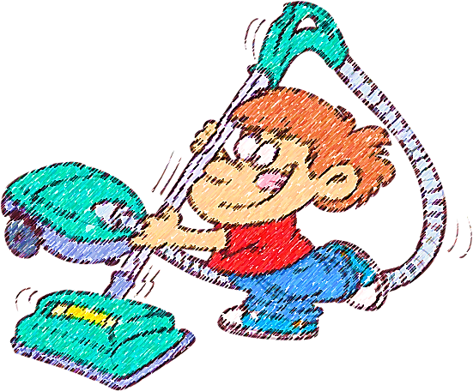
Click on the correct picture
vacuum the carpet

Slide 22
wash the windows

Slide 23
wash the clothes

Slide 24
cook the meals

Slide 25




wash the dishes

Slide 26
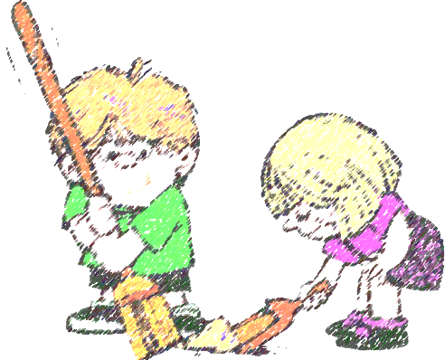
sweep the floor

Slide 27
make the bed

Slide 28

Do you help at home?

