Slide 1
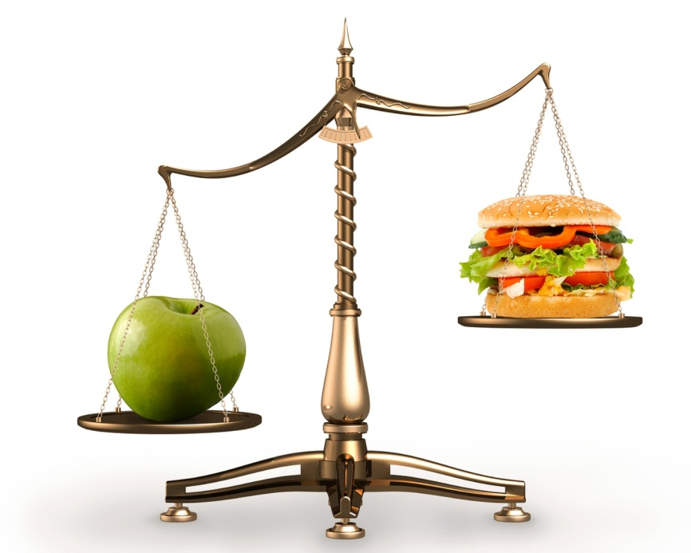
_{Healthy}
_{and unhealthy}
_{food}

Slide 2
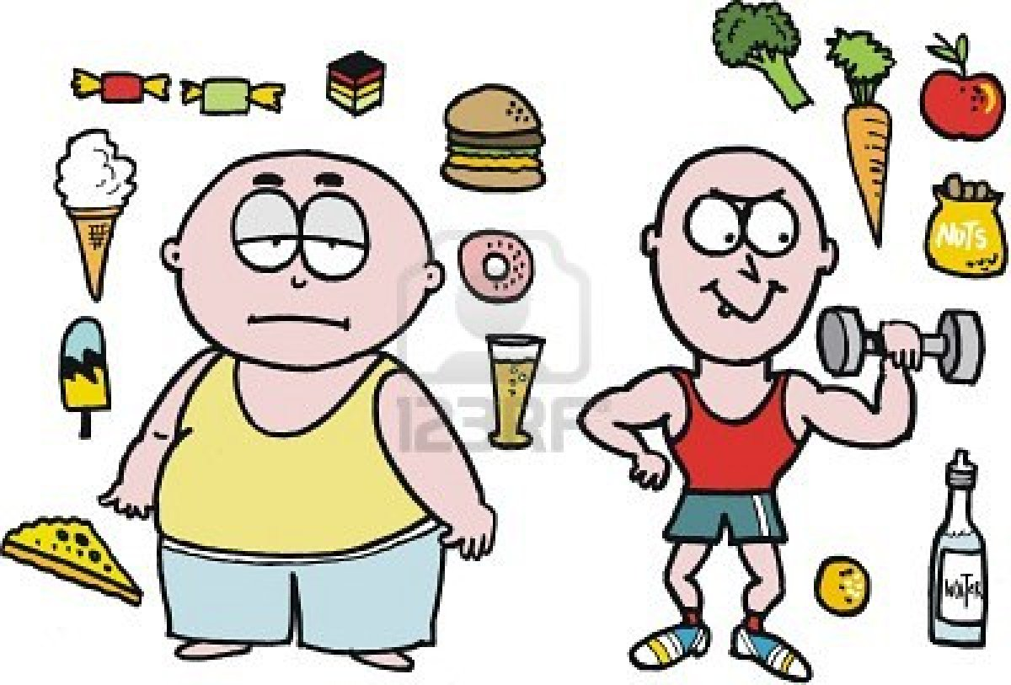
Plan
Nutrients food
What is junk
food?
3 What's wrong with junk food?
4 The eatwell plate

Slide 3
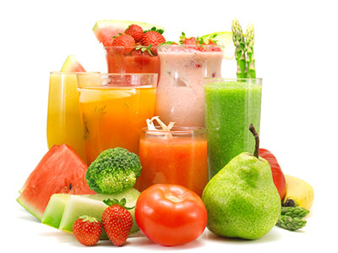
Nutrients food
All food is made up of nutrients which our bodies use. There are different kinds of nutrients: carbohydrates, proteins, fats, vitamins and minerals.
Before we cut down on fat, sugar and salt, we have to know a bit more about the kind of food these things might be in. The biggest problem comes when these things are hidden in other foods: biscuits, crisps, sausages, meat pies, soft drinks and so on.

Slide 4
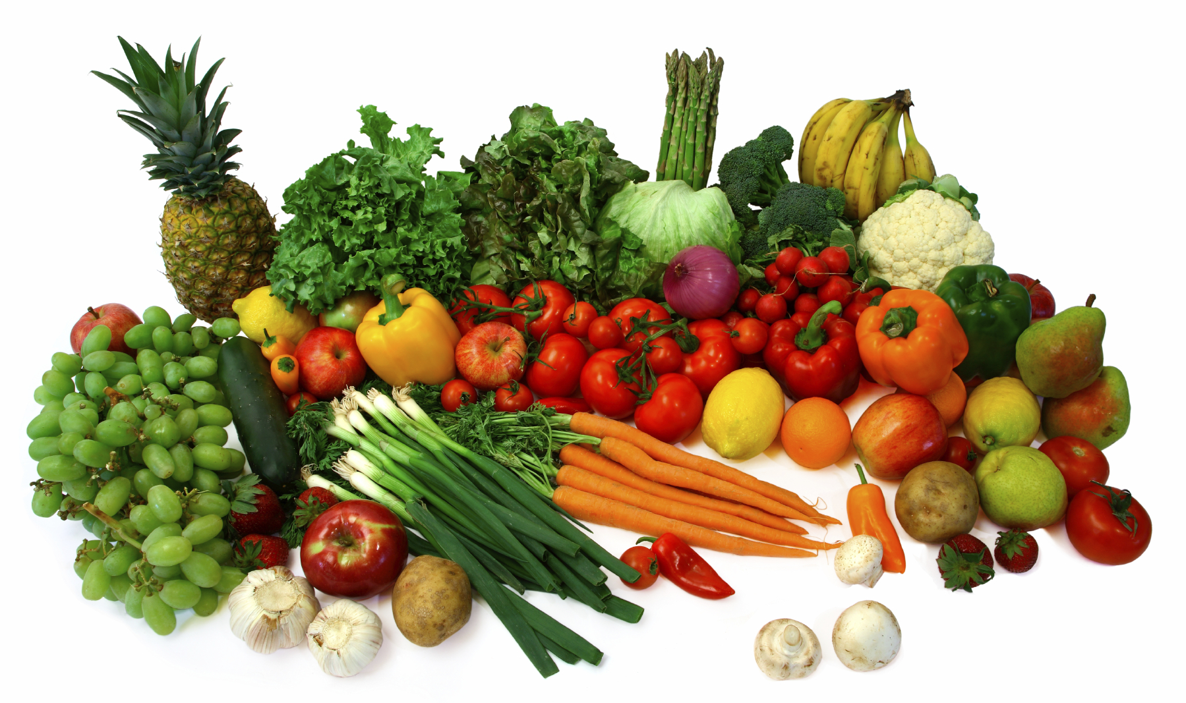
Healthy food

Slide 5
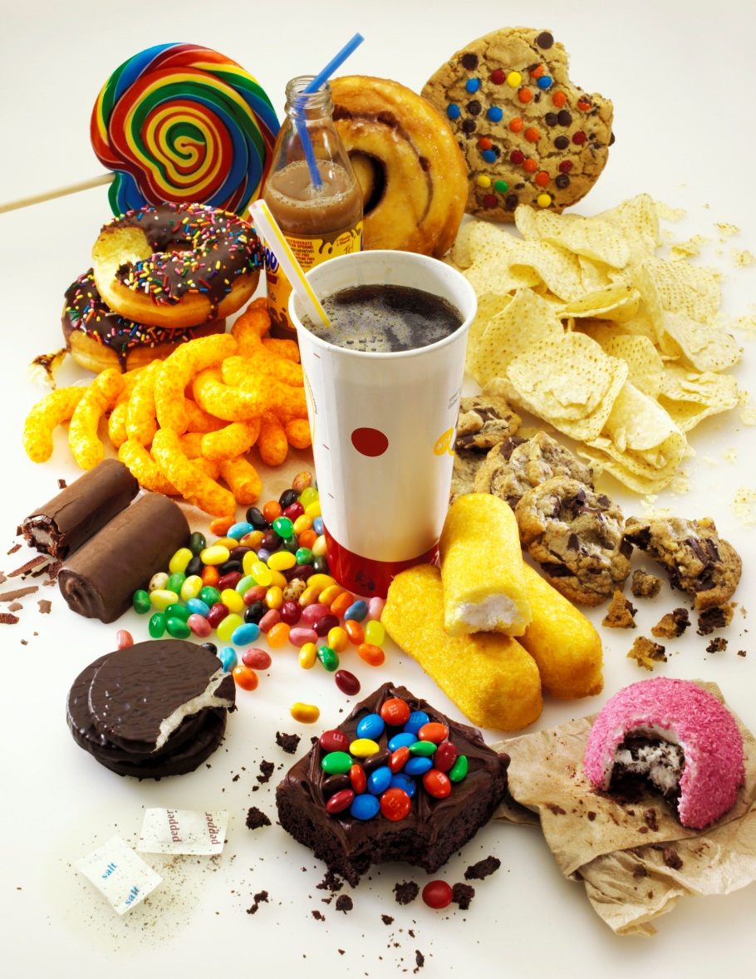
What is junk food?
Lollies, soft drink, potato chips, hot chips, ice cream, and hamburgers, hot dogs and other kinds of take away food are called junk food.

Slide 6

What's wrong with junk food?
Too much fat! Junk foods such as hamburgers, pizza, fried chicken and chips usually contain loads of saturated fats.
Too much sugar! Soft drinks, cordials, biscuits, cakes and lollies all have loads of sugar.
Too much salt! Junk foods often have too much salt. There's a lot of salt already in foods such as bread, breakfast cereals and biscuits and cakes.

Slide 7
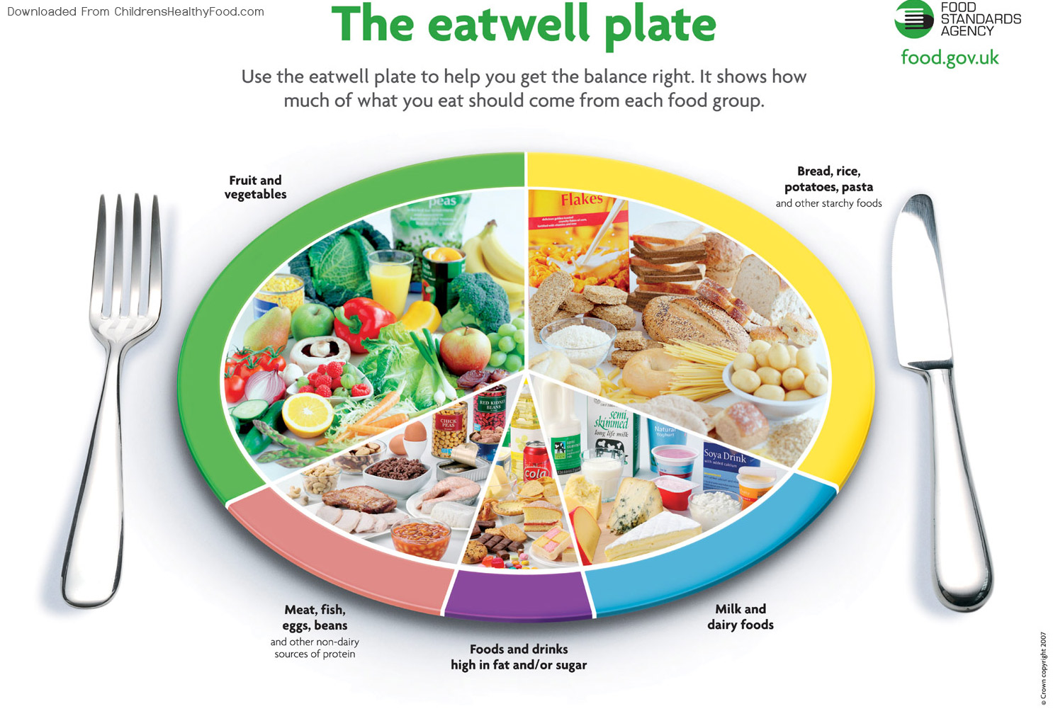

Slide 8
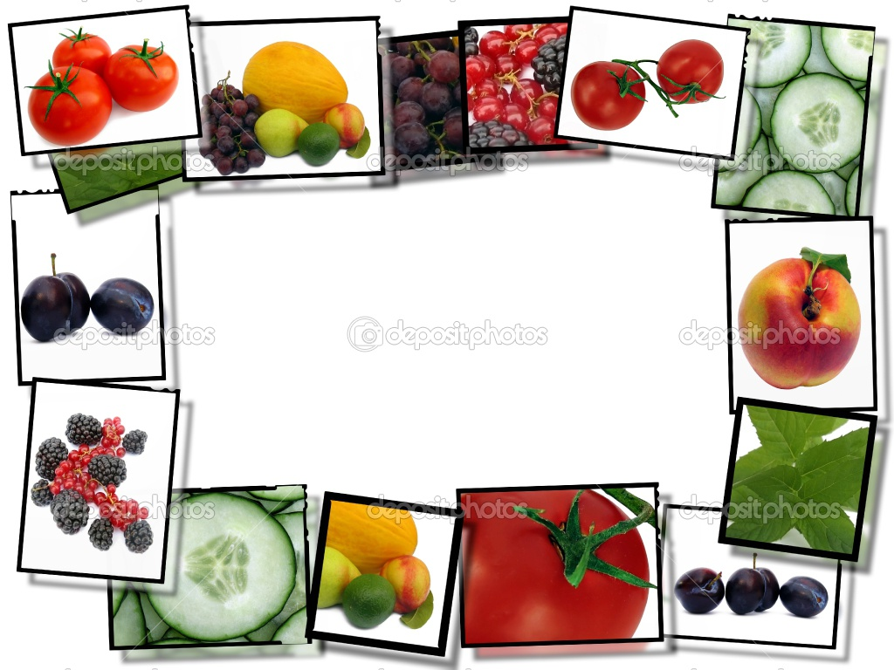
Thank you for your attention!

