Slide 1

It has no mouth but speaks.
It is not a tree but it has leaves.
It is not alive but it can be a good friend.
Today we are going to speak about one of the most wonderful things in the world. Well, try to guess what it is!

Slide 2

Books in our life
1

Slide 3
мета
дидактична: активізувати лексичні одиниці з теми «Книги. Жанрове різноманіття», які вивчалися протягом попередніх років (класів); практикувати використання вивченого матеріалу як в усному та і в писемному мовленні; формувати навички роботи в групах для вирішення спільних проблем;
розвивальна: продовжувати вдосконалювати навички читання (роботи з текстом для отримання необхідної інформації) та усного мовлення; розвивати комунікативні здібності, фонематичний слух, пам'ять, увагу, чітку й правильну вимову;
виховна: розширювати соціокультурну компетенцію учнів, їх кругозір; допомогти зрозуміти важливість читання та необхідність книги, як неперевершеного джерела інформації і незабутніх вражень.

Slide 4
What is a book?
A book …
is a source of
information
is a chance to
spend time
with pleasure
is a memory of
the nation.
is full of mystery.
You always don’t know
what will be in the end.
is always different
contains new ideas

Slide 5
Phonetic exercise:
[Ʊ] – book, look
[k] – character, create, catalogue, fiction, consult
[t∫] – adventure, century, choose, chapter, teach
[ei] – famous, tale, made, contain
[r] – write, writer, written, wrote
[ai] – like, library, librarian

Slide 6
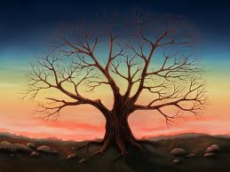
“Life without books is as tree without leaves”

Slide 7

^{The genres of literature}
All literature is divided into: fiction and science-fiction (non-fiction)
Detective stories
Adventures
Thrillers
Horror stories
Historical novels
Fantasy
Fairy tale
Short stories
Novels
Modern plays
Love stories
Essay
Poetry
Romances
Poems
Sonnets
Ballads
Tragedy
Drama
Biography
Encyclopedias
Atlases
Reference books
Dictionaries
Report
Articles

Slide 8
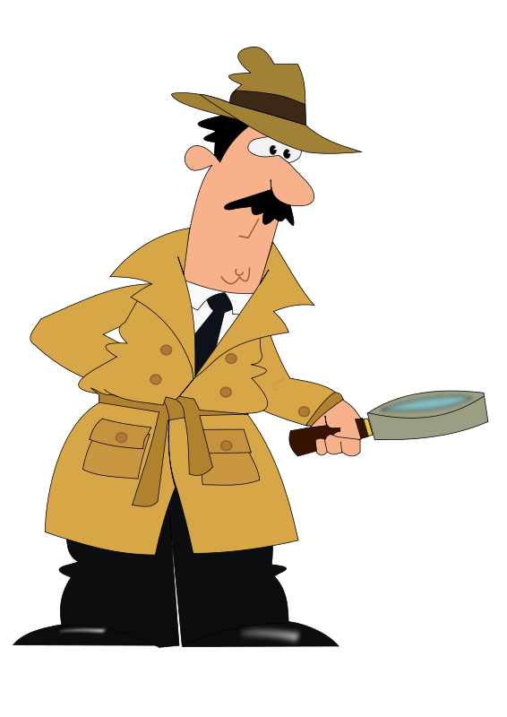
Read and define the genres of the books:
Criminals, robbers, killers. There is always a clever detective or a policeman who catches them in the end.
dectives

Slide 9


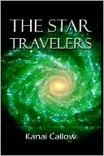
Aliens, spaceships, trips to the Moon and star wars.
Fantastic stories

Slide 10

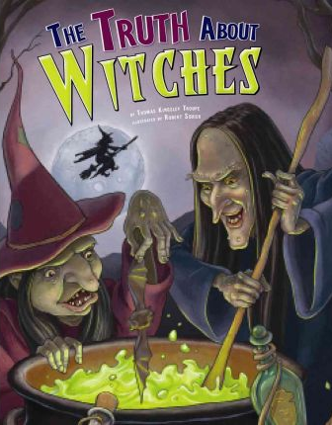
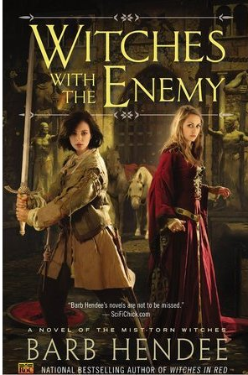
Wizards, witches and other magic objects that help good people. The story is usually long and the plot is complicated.
Fantasy

Slide 11
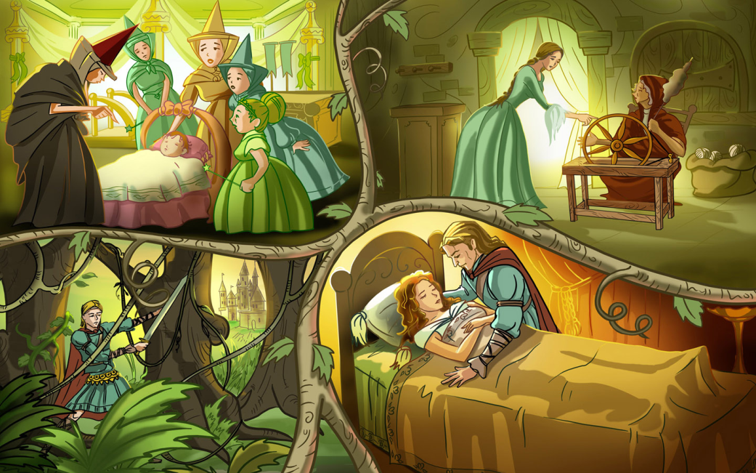
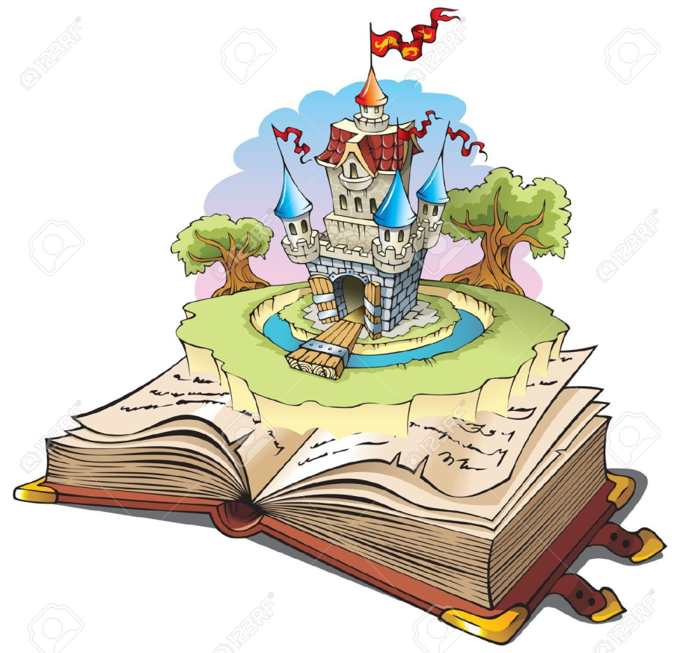
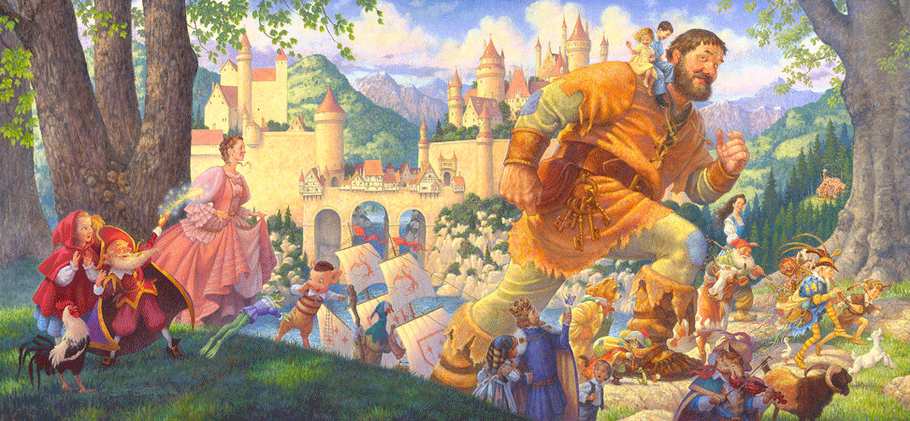
Princes and princesses, very bad witches and magic animals that help good people. The plot is usually very simple. Good people are rewarded. Bad people are punished.
Fairy tales

Slide 12

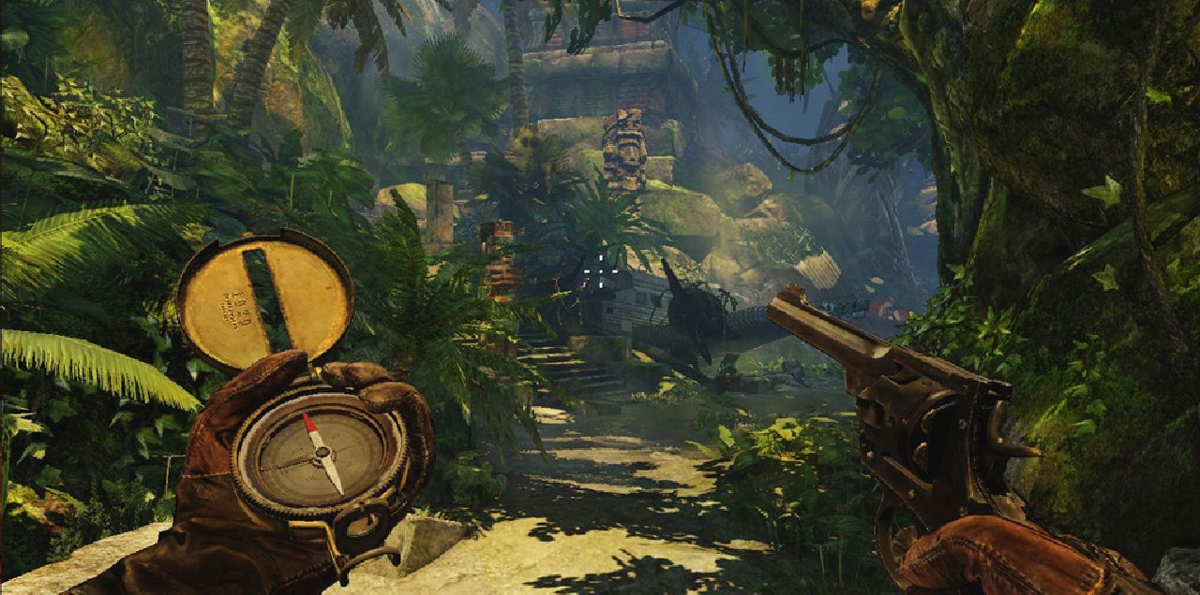

Pirates, cowboys, boys and girls are always doing exciting things. There are faraway islands, lost treasures, a lot of danger. But there is a happy ending.
adventures

Slide 13
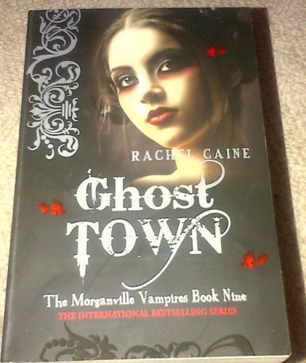
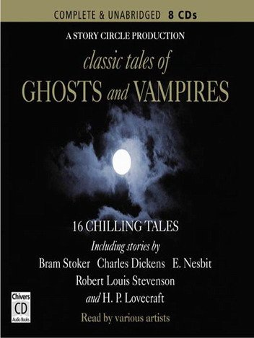
Vampires, witches, ghosts and scary supernatural events.
Horror stories

Slide 14

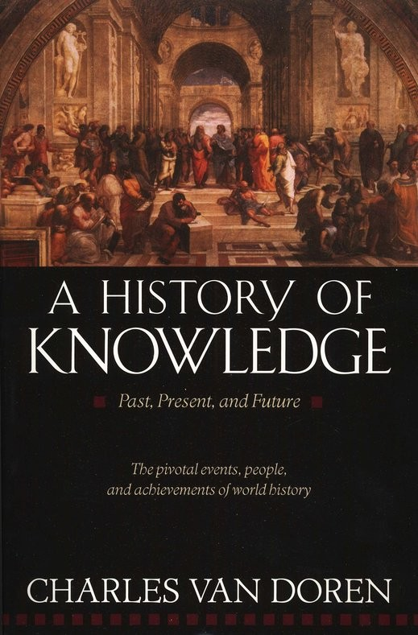


Things that happened in the past. Some characters may be not real, but the description of the period is good.
Historical stories

Slide 15
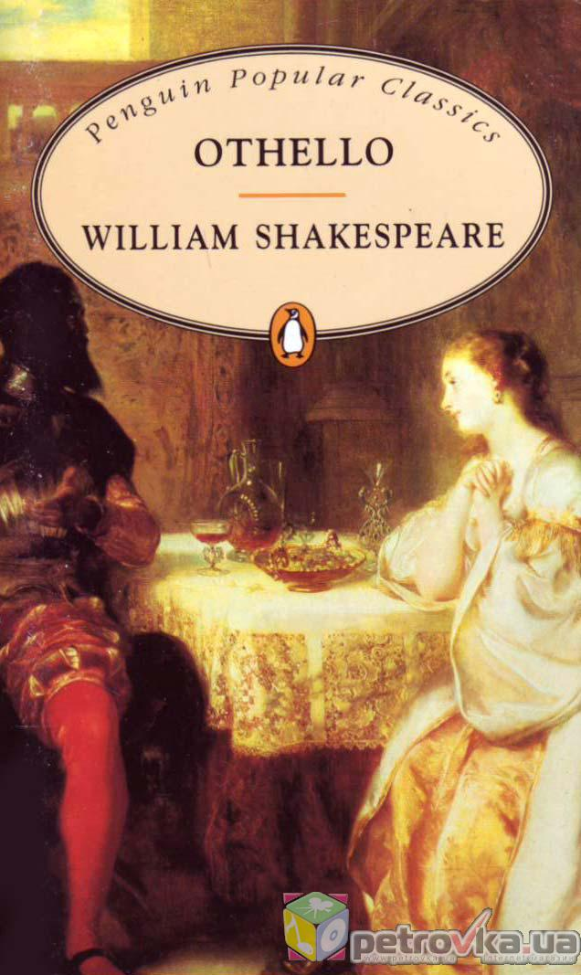



Love and hate.
The characters go through a lot of difficulties.
Love stories

Slide 16
Answer the questions
Have you ever seen the book?
How often do you take the books in your hands?
Have you ever read the book?
Where can you take the book?
Do you go to the library?
Do you have your home library?
What kinds of books do you have at home?
What kind of books do you usually read?

Slide 17
New vocabulary
An English proverb
A famous writer
To read books
To understand the plot
In general
To contain made-up stories
To give facts
To make copies
The invention of printing
The development
To develop
A title of the book
beforehand
Англійське прислів'я
Відомий письменник
Читати книги
Розуміти сюжет
Загалом
Містити видумані історії
Наводити факти
Робити копії
Винахід друкарства
Розвиток
Розвивати
Заголовок книги
заздалегідь

