Slide 1
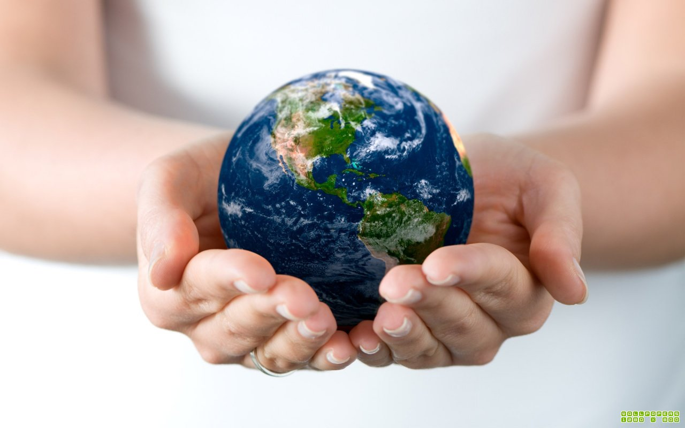
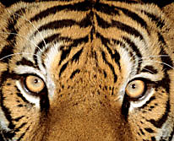
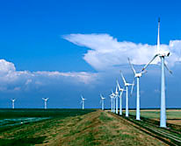
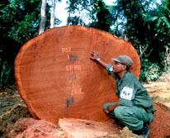
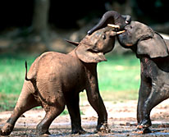
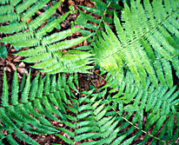
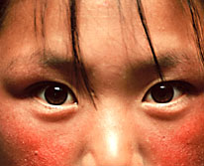
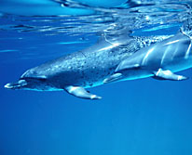
Nature. Environment. The Earth.

Slide 2
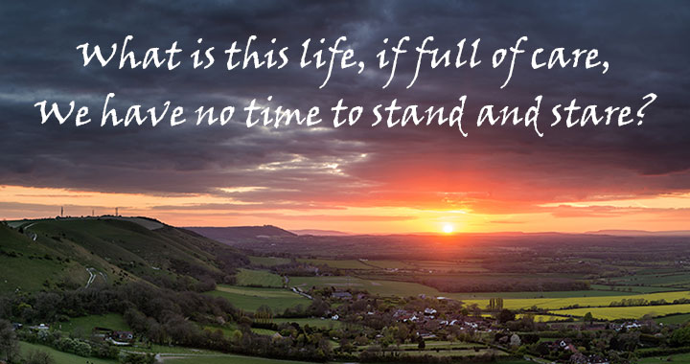

Slide 3
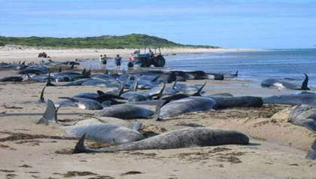
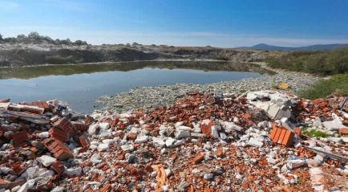
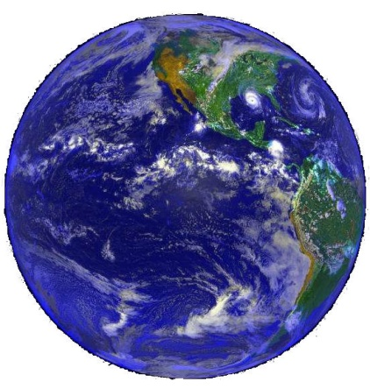
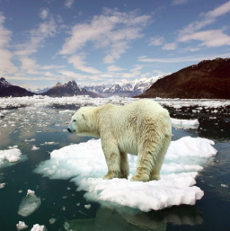
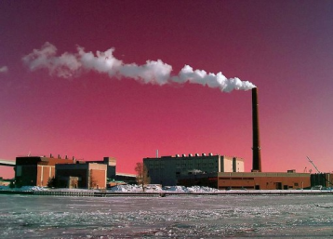
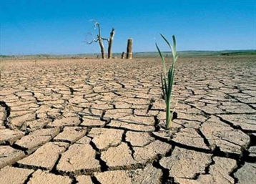
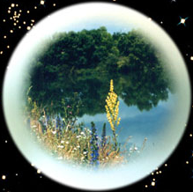
Earth
Nature
People
Landscape
Problems
Environment
Pollution
Water resources
Climate change
Wildlife
Disasters
Flora
Fauna
Overpopulation

Slide 4
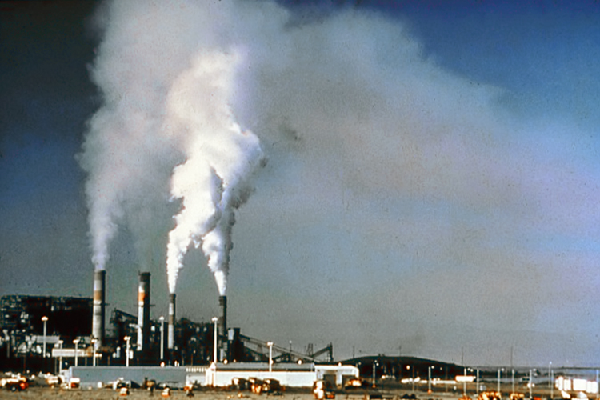
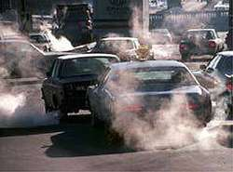
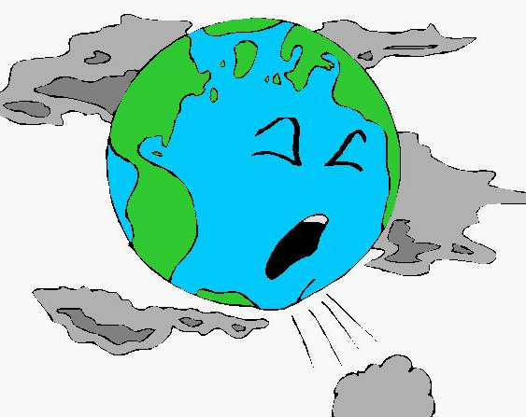
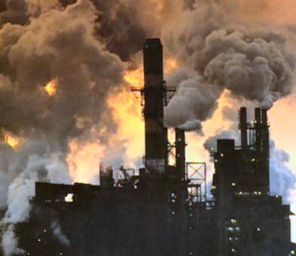
There are 5 bln tons of carbon monoxide emissions into the atmosphere every year. As a result the ozone layer gets thinner, ozone holes are appearing. The sunrays coming through these holes may cause people diseases, the most dangerous among which is cancer. There’s getting less and less oxygen left on Earth and there are more and more gases produced by transport, plants and factories.

Slide 5
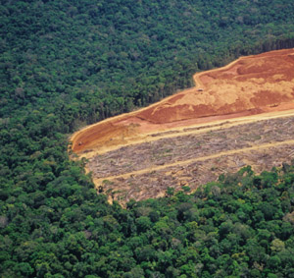
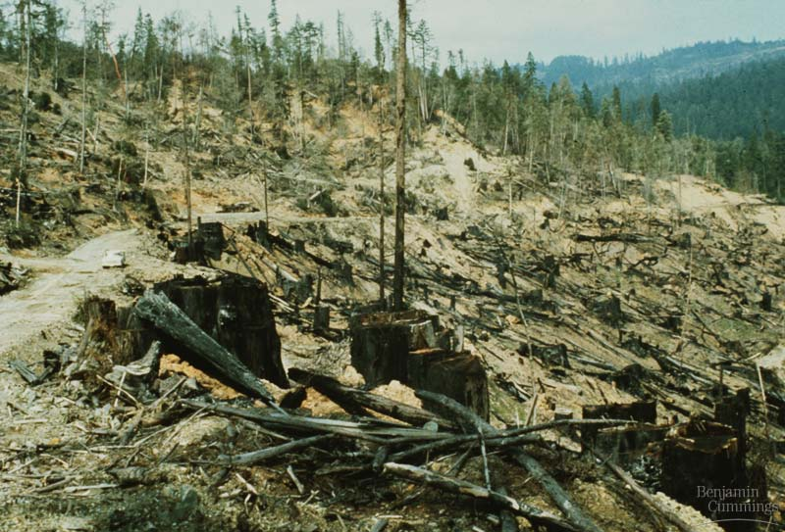

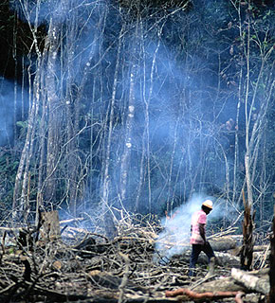
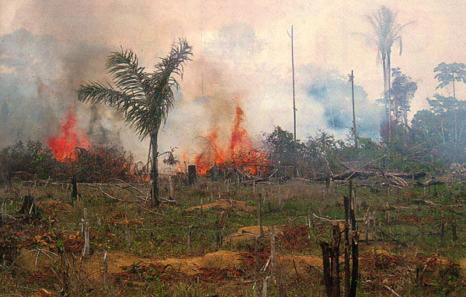
During the last 20 years people cut down as many forests, as it had been destroyed for their previous existence, not speaking about the fires caused by people. For many animals the forest is a home. But there are less and less forests on the planet. It means that animals
are losing their homes
and are in the danger of extinction.

Slide 6
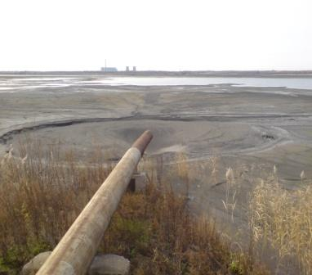
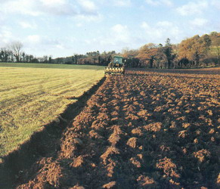
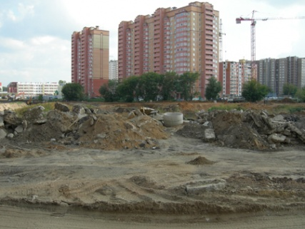
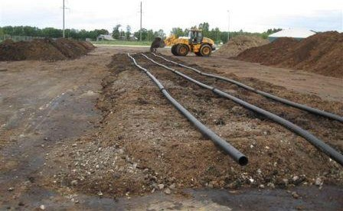
The process of forming soil is very slow: it takes hundreds and even thousands years. But to destroy it is very easy. During the last century people destroy nearly a quarter of all fertile lands.

Slide 7
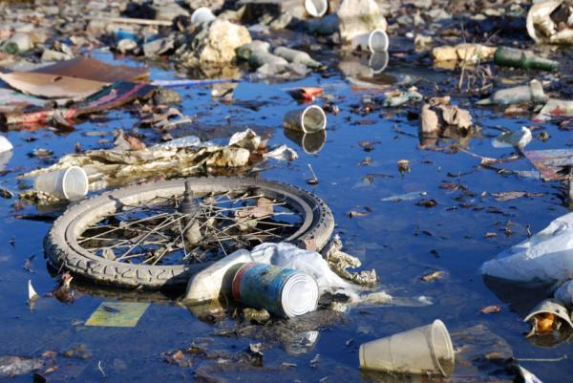
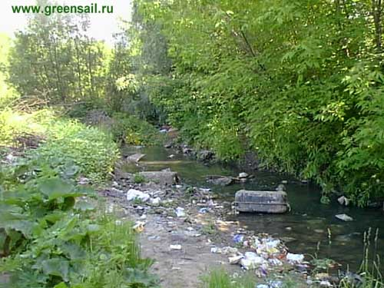
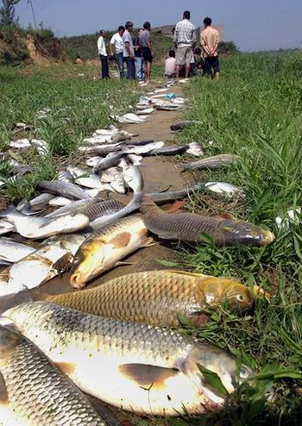
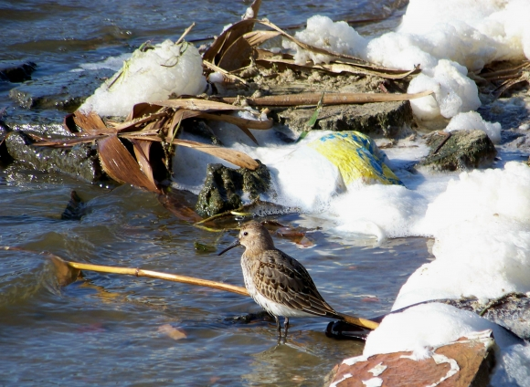
Scientists calculated, that every year so many poisonous things are getting into the rivers and seas, that they could be filled into 10,000 trains. Washing powder has even been found in the Arctic Ocean. As a result it is dangerous and sometimes banned to swim in such European rivers as the Volga, the Danube, the Rhein and many others.

Slide 8
Home task
p.166-167
Перекласти інформацію з таблички
Посилання на підручник
https://4book.org/uchebniki-ukraina/9-klass/pidruchnik-angliyska-mova-9-klas-karpyuk-2017-english/lesson-2-nature-and-the-environment/page-166

