Slide 1
У лікарні.

Slide 2
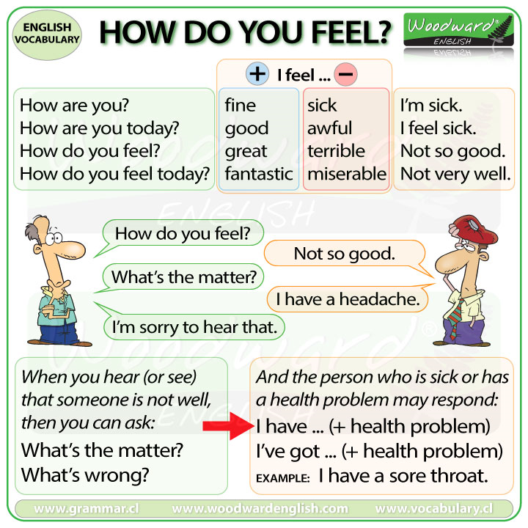

Slide 3
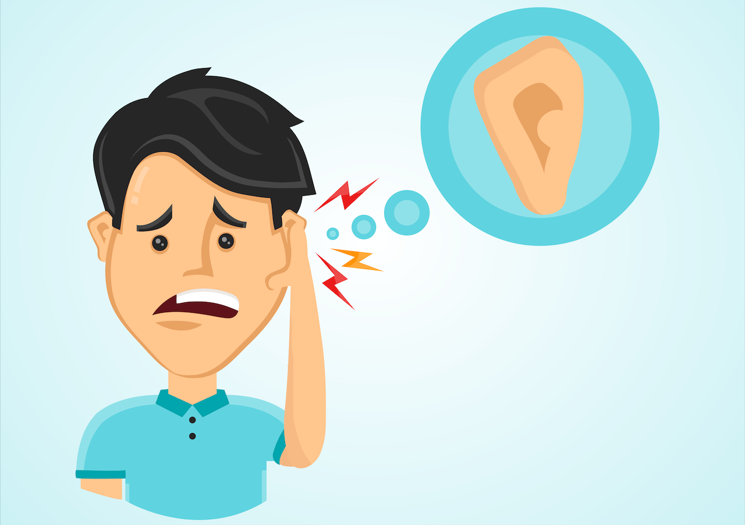
What`s the matter?
I`ve got earache.

Slide 4
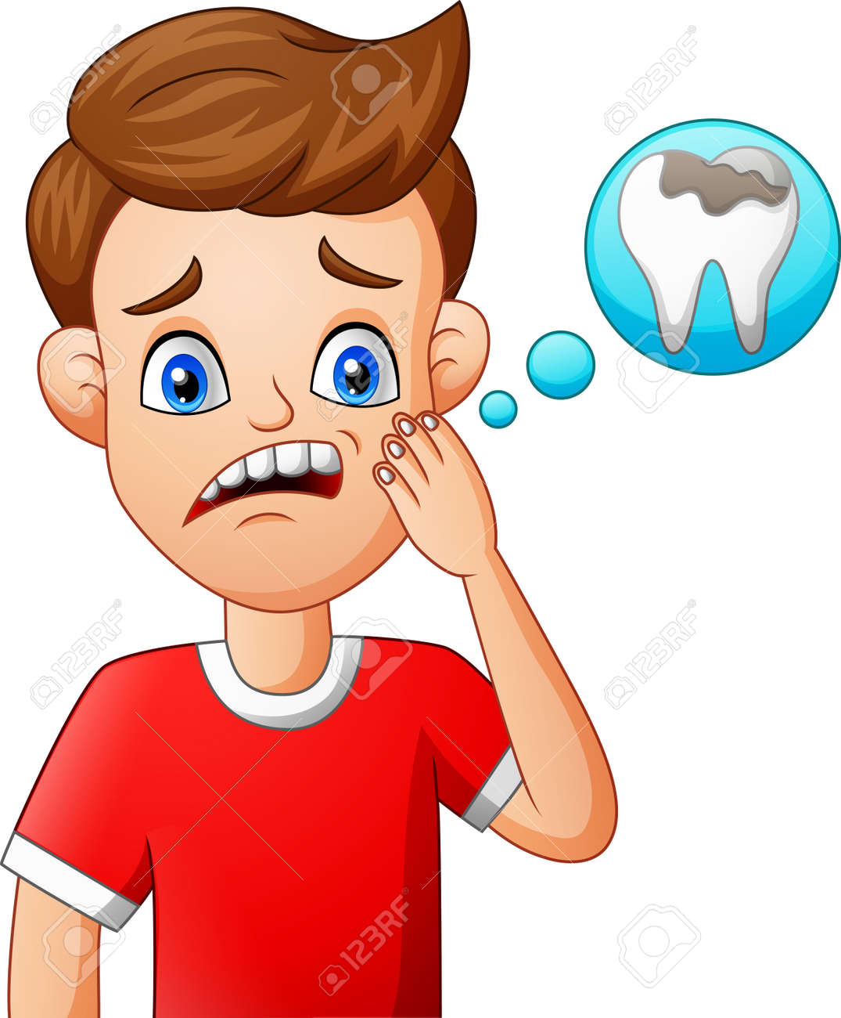
What`s the matter?
I`ve got toothache.

Slide 5
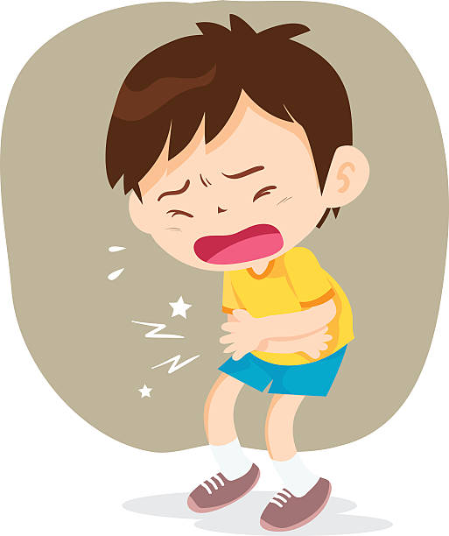
What`s the matter?
I`ve got stomach-ache.

Slide 6

What`s the matter?
    I`ve got a cough.

Slide 7
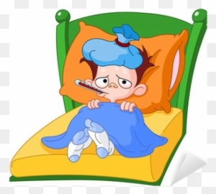
What`s the matter?
I`ve got a cold.

Slide 8
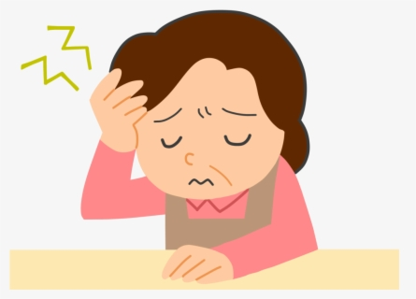
What`s the matter?
I`ve got a headache.

Slide 9
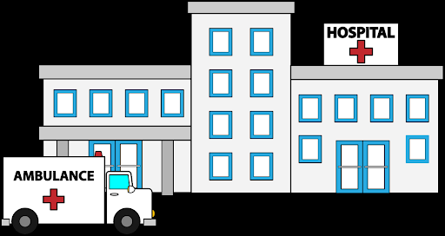
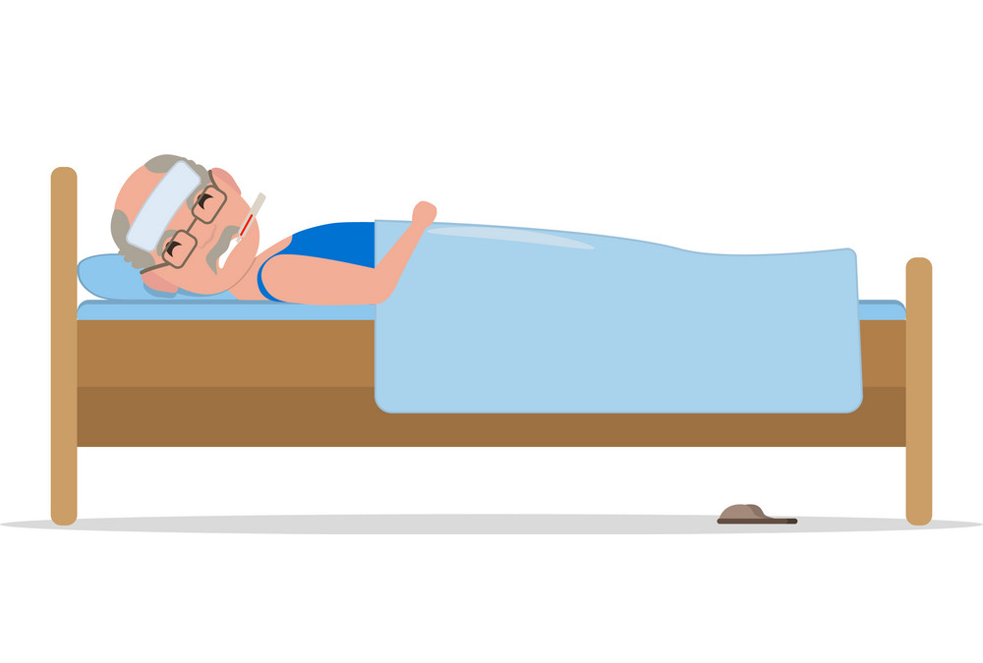

Listen and answer
Where is the grandpa?
How is the grandpa?
What is the number of his room?
Is this room upstairs or downstairs?

