Slide 1
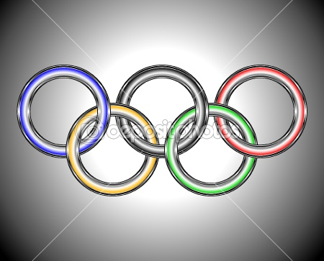
FAMOUS UKRAINIAN SPORTSMEN

Slide 2
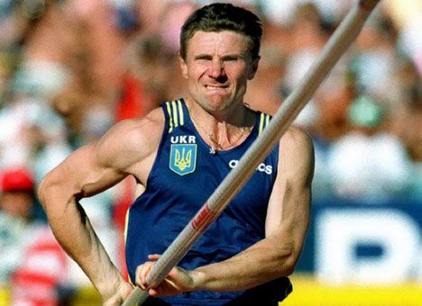
Sergey Bubka is a famous Soviet and Ukrainian pole vaulter, the outdoor world record holder, President of the National Olympic Committee of Ukraine, Vice President of IAAF.
Sergey started his sport career on the world athletics scene at the age of 18 at the European Junior Championships, where he took the seventh place in pole vault. In 1984 Sergey set his first world record in Bratislava, clearing 5.85 meters. Several weeks later he beat his own record to 5.6 meters.
In 1985 Sergey Bubka set the record, which was of real historical significance. He was the first athlete in the world to clear more 6-meter mark.
During the next ten years he was breaking his own record 35 times and improved it to 6.14 meters (1994). Since then Bubka’s record was not beaten by any other sportsmen and is still considered to be the best in the world.
Sergey Bubka

Slide 3
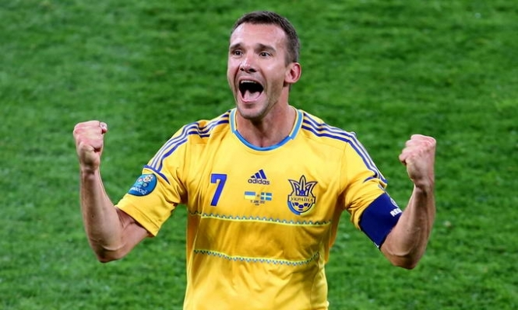
ANDRIY SHEVCHENKO
Andriy Shevchenko (Sheva) is a famous Ukrainian footballer, head coach of the Ukraine national team, the best striker in the history of Ukrainian football, the Golden Ball holder.
Shevchenko’s football career can be divided into four basic stages:
Dynamo Kyiv (1997-1999). In 1997 Shevchenko became famous throughout Europe in match against Barcelona, when he scored three goals. For his first “Dynamo” period Sheva scored 106 goals.
Milan (1999-2006). In 1999 Shevchenko left Dynamo for Milan. During the first season he became the best striker and scored 24 goals. In 2003 Milan won the Champions League and Shevchenko was awarded “Coppa Italia”, then “UEFA Super Cup”. Sheva finished his last season in Milan with 175 goals.
Chelsea (2006-2008). Although in his first match for Chelsea Andriy scored a goal, his football career in England wasn’t successful. Besides he went through two operations and his back injury. He decided to return back to Milan, after then to Dynamo Kyiv.
Ukraine national team. Shevchenko debuted in Ukraine national team in 1995. He played 111 matches and scored 48 goals. Since 2016 Andriy Shevchenko was appointed as the head coach of Ukraine national team.

Slide 4
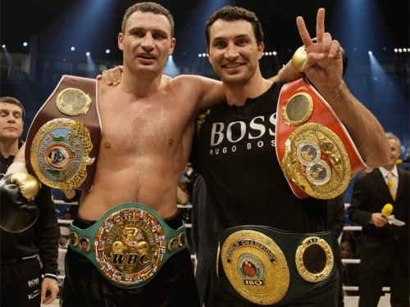
Vitalii (1971) and Vladimir (1976) Klitschko are world famous Ukrainian heavyweight boxers, world champions, PhD in physical education and sport. Vitalii, the elder brother, is also a politician and the mayor of Kyiv (since 2014).
Vitalii and Vladimir had their professional boxing debut in 1996 in Hamburg, where both brothers defeated their opponents. In 1999 Vitalii won his first world title (WBO) and set a world record — he won 25 serial battles by knockout during the first 6 rounds.
In 2008, after four-year break, Vitalii regained the WBC title in the battle against Samuel Peter and realized brothers’ cherish dream – to be world heavyweight champions simultaneously. By that time Vladimir was already world heavyweight champion (WBO, IBF, IBO). Three years later in 2011 he won one more title (WBA), so Klitschko brothers became the holders of all World Heavyweight Titles.
Vitalii Klitschko finished his sport career in 2013. He had a total of 47 fights, 45 wins and 2 losses. Nowadays Vladimir continues his professional career, by 2017 he had 68 fights with 64 wins and 4 losses.
Vitalii (1971) and
Vladimir (1976) Klitschko

Slide 5
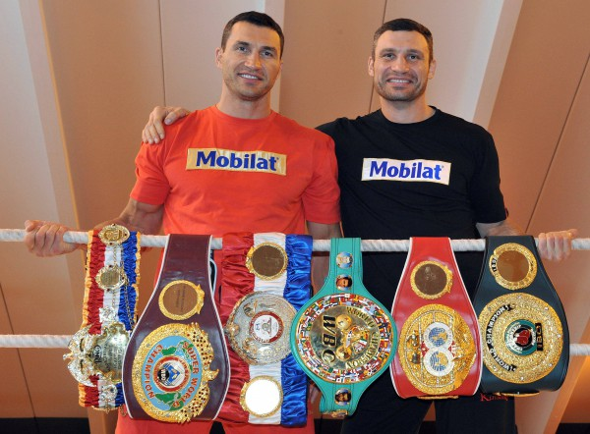
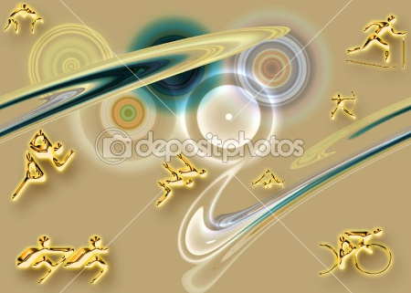
In 2008, after four-year break, Vitalii regained the WBC title in the battle against Samuel Peter and realized brothers’ cherish dream – to be world heavyweight champions simultaneously. By that time Vladimir was already world heavyweight champion (WBO, IBF, IBO). Three years later in 2011 he won one more title (WBA), so Klitschko brothers became the holders of all World Heavyweight Titles.
Vitalii Klitschko finished his sport career in 2013. He had a total of 47 fights, 45 wins and 2 losses. Nowadays Vladimir continues his professional career, by 2017 he had 68 fights with 64 wins and 4 losses.

Slide 6
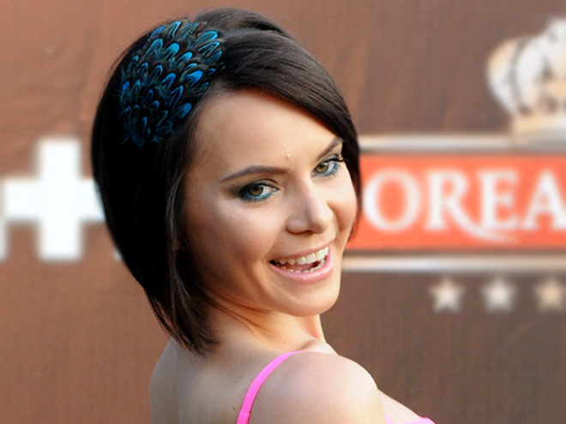
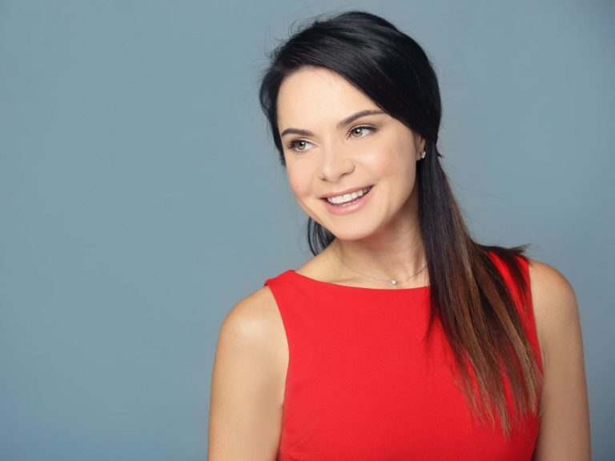
Lilia Podkopaeva is a prominent gymnast from Ukraine, Merited Master of Sports of Ukraine, world-around and Olympic Champion, the Judge of International Category.
In 1995 Lilia won European Cup and got the title of world all-around champion in artistic gymnastics. The next year Ukrainian gymnast won the gold medal at the European Championships. After all her victories Lilia set the next target – the Olympic Games.
Hard and long trainings, uncompromising work above itself and huge financial and moral costs helped Lilia Podkopaeva to win two gold medals at Summer Olympics in Atlanta in 1996. She took the first place in all-around event and in floor exercises. Her “double front somersault with half-twist” became her best-known item, which is still unattainable.
After retirement Lilia Podkopaeva switched to coaching. In 2012 she moved to the USA, where she gives master classes and lectures.
Lilia Podkopaeva

Slide 7
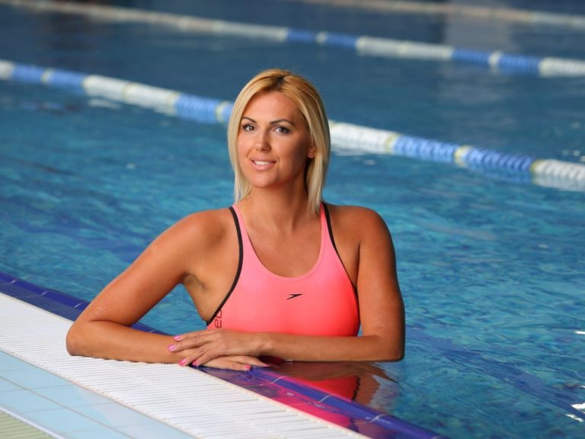
Yana Klochkova (1982)
Yana Klochkova is an outstanding Ukrainian swimmer, four-time Olympic Champion, the most titled Ukrainian Olympic champion in the history of the Olympic games.
Yana’s sports biography is replete with victories and medals from the early years of her fascination with swimming. The start of her sport career at the age of 14 was marked by the second place at European Junior Championships in Denmark. One year later she won the gold medal in Glasgow.

Slide 8
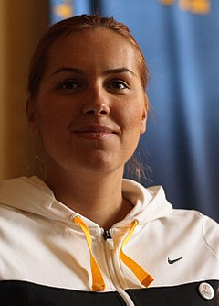
Klochkova was three-time European champion in 1999 and 2000 (Lisbon, Helsinki, Valencia). The sportsman set 50 Ukrainian records in different types of swimming: medley, freestyle, backstroke and butterfly.
Ukrainian “goldfish” also won the World Championships in a short course in 1999 in Hong Kong. She went on winning new gold and silver medals during 2000 – 2004.
Her participance at the Olympic games brought Yana five medals:
two gold and one silver medal in Sydney (2000);
two gold medals in Athens (2004). In Athens Yana got the title “Swimmer of the year”.

Slide 9
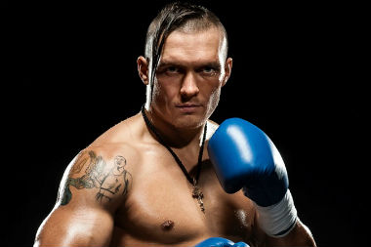
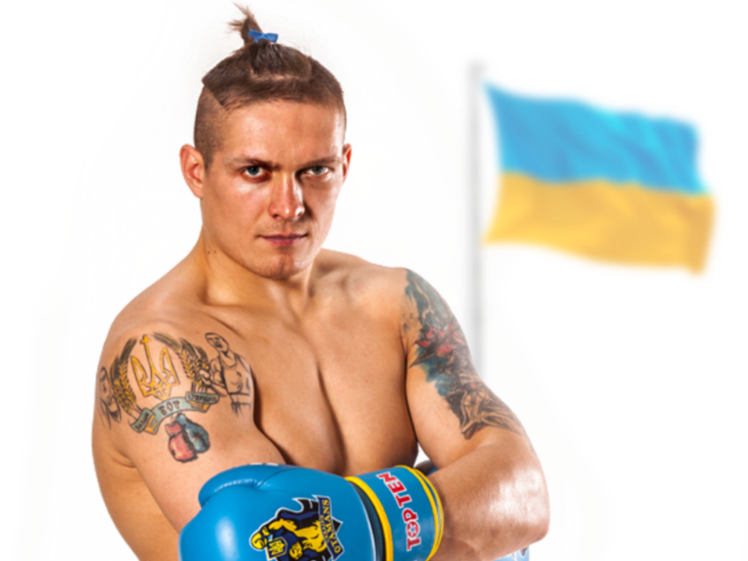
Oleksandr Usyk is a prominent professional boxer from Ukraine, WBO world champion, Olympic Champion, Honored Master of Sports of Ukraine.
He began his amateur career in 2006 at European Championships, where he took the third place. In 2008 in Liverpool Usyk defeated all his opponents and won the gold medal. But he achieved his real success at the Olympic Games in 2012, London, when he beat three serious boxers from Russia, Bulgaria and Italy and won the Olympic gold medal.
In 2013 Oleksandr Usyk decided to start professional boxing career. He signed a contract with the Klitschko brothers’ promotion company “K2 Promotions”. In 2014 Oleksandr won his first WBO interim junior-cruiserweight title defeating Daniel Bruwer from South Africa. He defended his title four times to rise up the rang.
Summing up all professional Usyk’s fights he had 11 wins and no losses.
Oleksandr Usyk

Slide 10
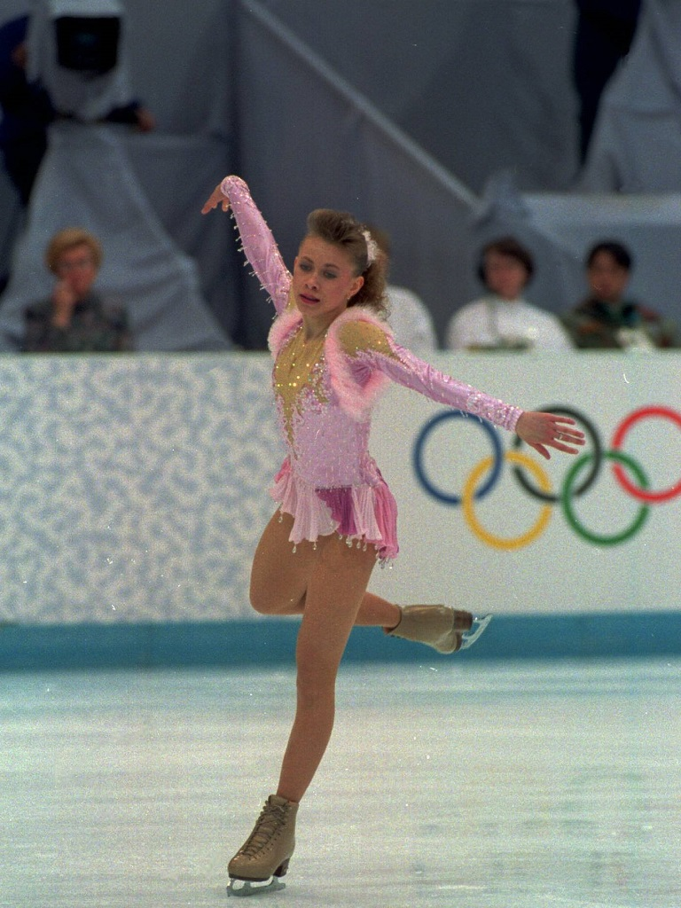
Oksana Baiul
In the beginning of 1993 young Ukrainian figure skater debuted in European Championships. Despite her two falls in free program Oksana managed to perform extremely complicated triple loop jump and triple lutz and took the silver medal. Also in 1993 her amazing performance in World Championships in Prague left no chance to other participants and brought Oksana Baiul the gold medal.
In 1994 during Winter Olympics Oksana Baiul skated one of the most perfect programs in the figure skating history. She took the Olympic gold medal but her victory wasn’t easy. Prior to Baiul’s performance during the practice skating she collided with German skater who injured Oksana’s shin with a skate blade. But even pain and three stitches on her leg couldn’t prevent Oksana Baiul from becoming the Olympic Champion.
After the Olympic Games Oksana moved to the USA, where she went on skating professionally

Slide 11
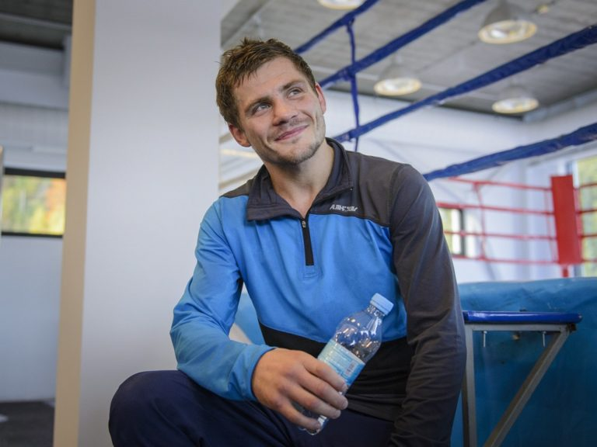
Denys Berinchyk is a famous Ukrainian professional boxer, Merited Master of Sports, Olympic Silver Medalist (2012), World Championship Silver Medalist (2011).
In the 2012 Summer Olympics in London Denys Berinchyk competed in light welterweight boxing. He gracefully defeated Swedish, Mongolian and Australian opponents, but lost in the final he and took the silver medal.
During 2012 -2014 Denis took part in the World series of boxing in the team “Ukrainian Atamans”. In 2015 Berinchik decided to switch to professional boxing and signed a contract with the Klitschko brothers’ company “K2 Promotions”. He had 5 fights with 5 wins and no loss.
Denys Berinchyk (1988)

Slide 12
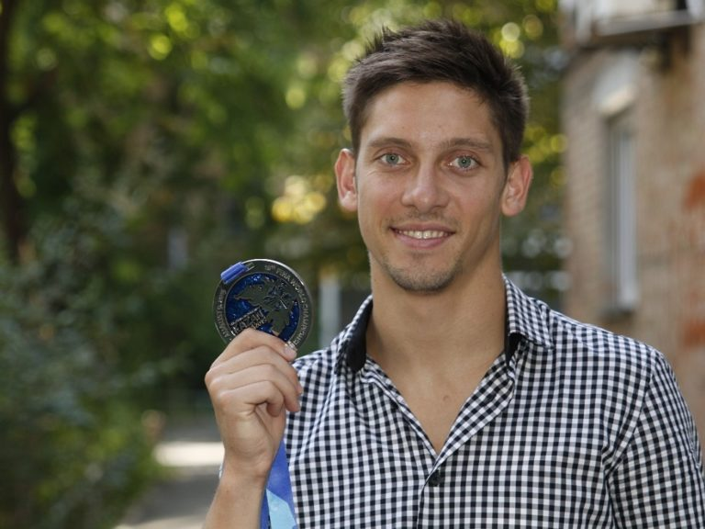
Ilya Kvasha is a perspective diver from Ukraine, Olympic Bronze medalist (2008), the sevenfold European champion, Master of Sports of International Class.
His first sporting achievements young Ukrainian diver demonstrated in 2004, when he won gold at European championships in 1m and 3m springboard. He also took gold six more times at the championships in Europe. At the World Championships he won silver medals in 2006, 2013, 2015.
2008 Summer Olympics in Beijing made Ilya Kvasha world famous. He won the bronze medal in 3 m spring synchro together with Aleksey Prigorov. In 2012 Ilya and Aleksey competed at Summer Olympics in London, where they took the 4th place. Rio 2016 Olympic Games brought Ilya Kvasha the 6th place.
Ilya Kvasha (1988)

Slide 13
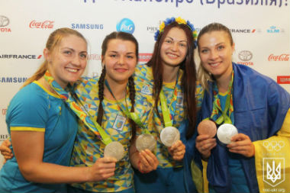
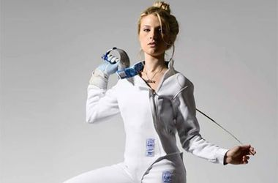
Olga Harlan, Halyna Pundyk,
Olena Hromova and Olga Zhovmir
Olga Harlan, Halyna Pundyk, Olena Hromova and Olga Zhovmir are Ukrainian fencing team. Olga Harlan is the leader of the team. In 2008 they participated in the Olympic Games in Pekin and became the Olympic Champions. In 2009 Olga Harlan became Europian Champion. She won the title of World Champion four times. In 2012 in London she won the bronze medal and the title of the Olympic Champion.

Slide 14
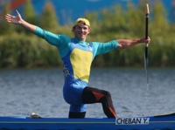
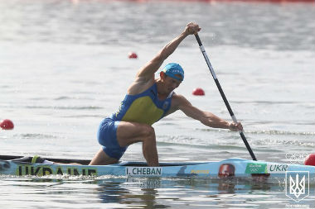
Yuriy Cheban was born on July, 5 1986 in Odessa. He goes in for rowing. He is a sport master. He is a member of Armed Forces team of Ukraine .His first coach is Evgen Lesyak. V.Sorokin and L. Cheban have been training him for some years. In 2008 he took part in the Olympic Games in Pekin and won the bronze medal in canoe rowing for distance 500 m. He became the Olympic Champion in London in 2012 and won the gold medal for distance 200 m. He has State Awarding.
Yuriy Cheban

Slide 15
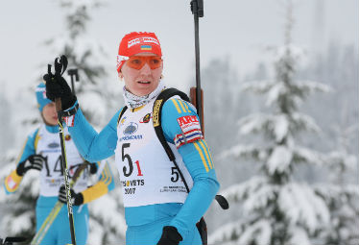
At the 2017–18 Biathlon World Cup she won silver. Pidhrushna carried the Ukrainian flag during the opening ceremony of the 2018 Olympics in Pyongyang. She represented Ukraine at the 2010 Winter Olympics in Vancouver.[1] Her best result at that Games was rank 12 in mass start. 2013-14 season started for her quite successfully with one podium in January. Together with Juliya Dzhyma, Valj Semerenko and Vita Semerenko she won the gold medal in the Women's relay at the 2014 Winter Olympics, in Sochi, Russia. Pidhrushna took a break in her sport career at the end of the 2013-14 season, and was subsequently appointed Deputy Minister of Youth and Sports in the Ukrainian government.She qualified to represent Ukraine at the 2018 Winter Olympics. Pidhrushna carried the Ukrainian flag during the opening ceremony of the 2018 Winter Olympics. She is Olympic and World champion, multiple medalist of different high-level competitions. Pidhrushna is considered to be one of the most successful winter sports athlete in Ukraine. She lives in Ternopil.
Olena Pidhrushna
This Ukrainian biathlete is known for winning Olympic gold at the winter games in Sochi in 2014. This brought Pidhrushna, as well as all of the biathlete female team, national recognition and love. Pidhrushna is also a World champion and five-time European champion. In 2014-2015 she was a Deputy Minister of Youth and Sport of Ukraine.

Slide 16
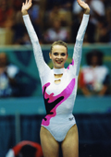
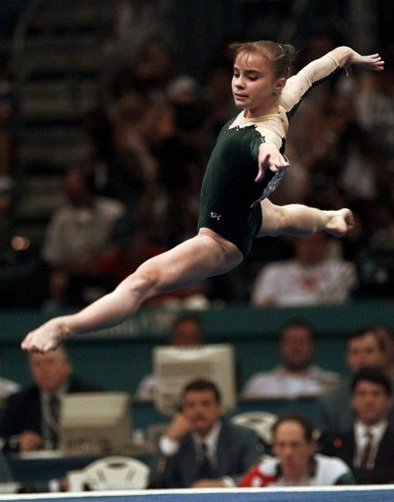
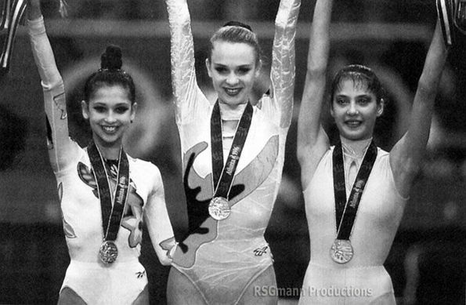
Kateryna Serebrianskaya started gymnastics in 1982 at age 4, her mother Liubov was her coach, at the Gratsia club in Simferopol. After that she went to the Ukrainian capital, Kiev, to train at the Deriugins School. Kateryna retired from Rhythmic Gymnastics in 1998. She is 178 cm / 5.8 ft in height.
Serebrianskaya became the first female rhythmic gymnast to hold the European, World, and Olympic all-round titles at the same time. This record was tied by Alina Kabayeva at the 2004 Athens Olympics.
Kateryna Serebrianskaya

