Slide 1



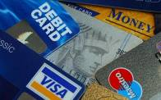

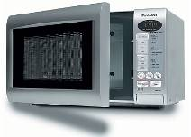

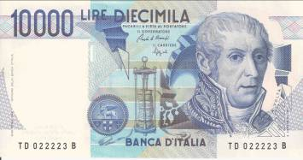
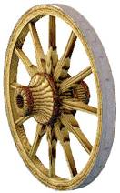
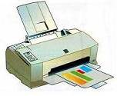
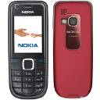
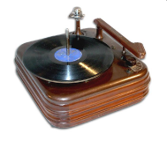

Inventions and Inventors

Slide 2
  The aims of the lesson:
  to develop students’ speaking skills
  to train skills of interpreting information (analyse, compare, choose)
  to motivate students to express their own point of view on the topic
  to get knowledge about ancient civilizations, important inventions and inventors
  to stimulate students to learn the world and its achievements

Slide 3
The motto of the lesson
«Necessity is the mother of inventions»

Slide 4
REASONS FOR INVENTIONS
Necessity of communication
Post-office
Telephone
Mass-media
The Internet

Slide 5
To save time while travelling
Bicycle
Car
Bus
Scooter
Train
Steamer
Ship
Helicopter
Plane

Slide 6
Need of entertainment
TV
DVD player
Game console
Tape recorder
Video player

Slide 7
To solve problems of health
Denture
Eye-glasses
Wheel chair
Artificial limbs
To enlarge productivity
Production line

Slide 8
Human’s curiosity
Satellite
Rocket
Scuba
Laziness
Remote control
Cell phone

Slide 9
To make life easier
Washing machine
Mixer
Blender
Iron
Hairdryer
Dishwasher
Multicooker

Slide 10
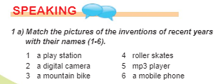
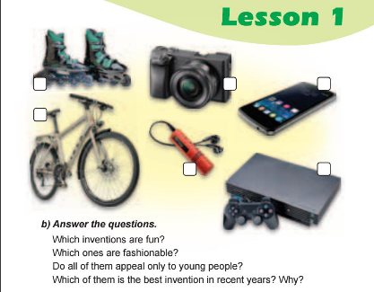

Slide 11
Look at the spider net and say about your favourite gadget
Mobile phone
Mp3 player
Computer
Favourite gadget
Washing machine
Vacuum cleaner
TV set
Refrigerator
Microwave

Slide 12


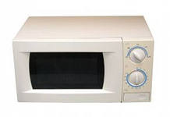
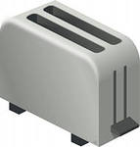
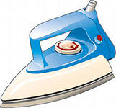
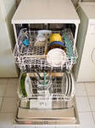
What is this?
1. A machine that is used for washing dishes.
2. A machine that is used to clean carpets, furniture and the floor.
3. An oven that cooks or heats food very quickly.
4. A machine that is used for mixing food.
5. A machine that is used for making toasts.
6. A small electric appliance with a flat metal base that is heated and used to press clothes.

Slide 13
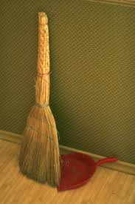
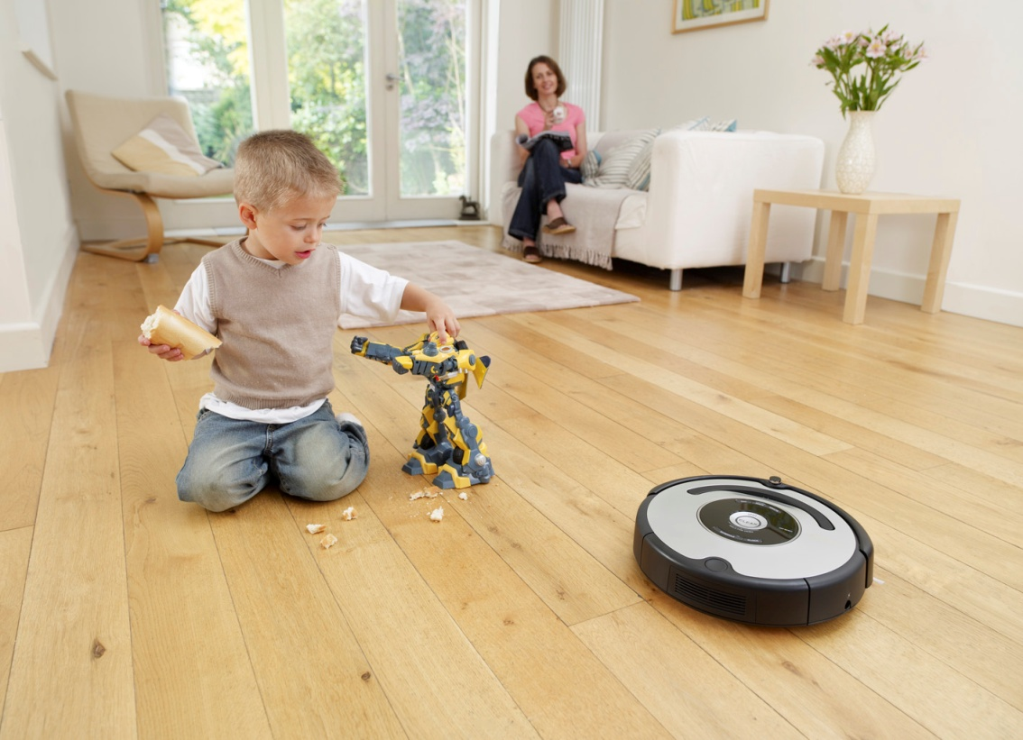
From the mop - to robot vacuum-cleaner

Slide 14
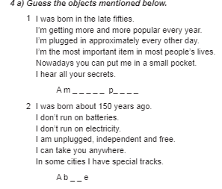

Slide 15
Final conclusion
You have heard many interesting facts, impressive information about inventions and inventors. I hope that this information was useful for you. And I want to finish our lesson with Sophocles’ words:
“Wonders are many and nothing is more wonderful than man”

Slide 16
Reflection
Mark plus or minus
 | The Content | + | -
1. | I know the main achievements of ancient civilizations and can make a short report on one of them.
2. | I can choose necessary information from the text, sum up and compare it.
3. | I can share information I have got with my classmates.
4. | I know the reasons of inventions .
5. | I can name some of the inventors and their inventions.
6. | I have got interesting information for myself.
7. | Was it interesting for you?

Slide 17
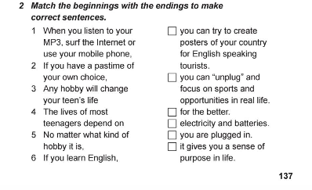
Домашня робота:

